Slide 1
Welcome Volunteers!
Please sign in & make yourself a name tag.
Don’t forget to grab a volunteer training packet.
Coffee & tea are available in the back. Treat yourself!
We’ll start shortly!
Notes:
Section: Introduction
Content Description: Set training expectations, rules, introductions
Support Materials: Snacks
Est Time
Slides Edited: #3 (changed title from Benefits Hub to Intake & Benefits Specialist)

Slide 2


#UWKC

Slide 3

  The Free Tax Prep Campaign
    Intake & Benefits Training
Notes:
Sometimes we will refer to your role as “VIBS,” a volunteer intake benefit specialist.

Slide 4



Welcome!
    Introductions
Your name and site
Something you’re excited to learn or achieve this season
1
2

Slide 5
    Training Roadmap
Campaign overview
Resources
Site Operation & Flow
Intake & Screening
Cultural Humility
Standards of Conduct
Benefits: Referrals & Data Tracking
Basic Food & Healthcare
Utility Assistance
Financial Coaching Services
Credit Pulls
Practice & Review
Notes:
Section: Campaign Overview
Content Description: Describe how the tax prep campaign connects to UWKC overall mission, why it is needed in our community. The impact by numbers the campaign has made so far, and how the campaign is done and makes it happen
Support Materials:
Est Time

Slide 6

    Campaign Overview
Notes:
Giving the viewer some variety in side banner slides and bottom banner slides is nice.
This bottom banner slide is good if your bullet points lean more toward the 7-word limit per bullet!

Slide 7
    The Free Tax Prep Campaign
Provides free tax prep to low-income populations
  No fees ever
  Access to EITC, the greatest poverty reduction tool in the nation
Financial Empowerment
  Low barrier savings options
  Connection to Financial Counseling services
  Benefits Access
Notes:
At United Way, together, we’re building a community where people have homes, students graduate and families are financially stable. The Free Tax Prep Campaign is a signature effort of United Way of King County's goal of alleviating poverty for 50,000 individuals and families by 2020. During the duration of tax season, we help thousands of low-to-moderate income families and individuals prepare their taxes and connect them to many different resources. This countywide program functions with over 1,000 volunteers at 30 tax sites. We collaborate with other service providers in the community - Community Centers, Libraries, Goodwills - to host these tax sites during tax season.
A lot of people don’t know all we offer through these tax clinics.

Slide 8


Why we do this work
    Why we do this work
One in five eligible taxpayers aren’t claiming the EITC.
$
In King County, 41% of people who claim the EITC go to a paid preparer!
Notes:
EITC is a powerful anti-poverty tool to tackle the problem.

Slide 9

    Why we do this work
Notes:
https://www.youtube.com/watch?v=_E_p9b3LNQw

Slide 10
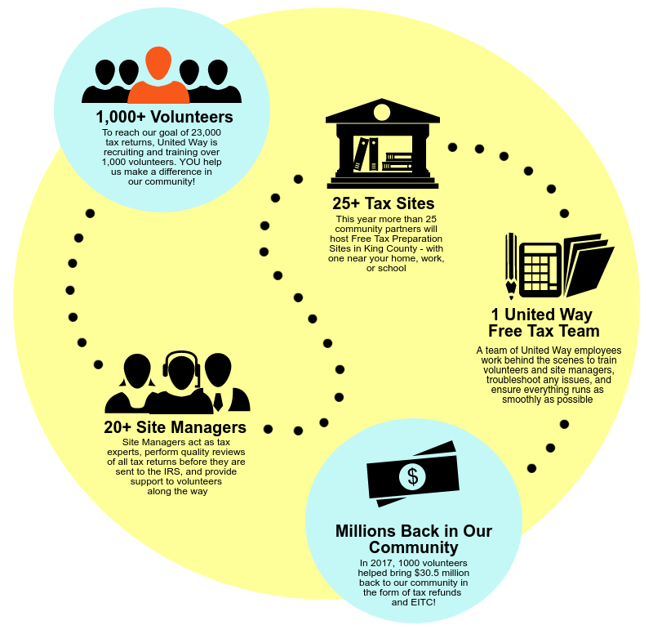
    How it works

Slide 11

Services Available
    Services at our sites
4
Tax Preparation for up to four years
Foreign Students Tax Help
PASS
Access to benefits: Emergency Savings, ACA, Basic Food, Credit Reports, Utility Assistance Referrals, Financial Coaching Service, Orca Lift
ITIN Applications & Renewals
Notes:
People can only get refunds on returns back 2OR3 years.

Slide 12


      Foreign Student Filing
Now able to file foreign students’ taxes with the foreign student certified tax volunteers:
In-person tax prep at the UW-VITA site
Drop-off available at Bellevue College, Green River College and Shoreline Community College
Notes:
Applies to all non-citizen students
If they work and get an ITIN, they do have to file taxes.
If they worked but don’t have a SS# or I-10, they don’t have to file taxes, but they can—it’s good to.
We don’t do this kind of tax prep; go to this site in person. But drop-off is a pilot program this year; clients come in with all the paperwork; we scan and send it to UW; this is because we only have the UW-VITA site (pronounced “V-eye-ta”);
VIBS will have this site info in the binder and online; Green River College is in Auburn. These 3 colleges have a lot of international students.
If students show up at other sites, give them this info.

Slide 13
      ITIN Certified Acceptance Agents
El Centro de la Raza | Burien Goodwill
Tuesdays, from 5:00 PM – 9:00 PM Thursdays, from 5:00 PM – 9:00 PM Saturdays, from 10:00 AM – 4:00 PM | Thursdays, from 5:00 PM – 9:00 PM Sundays, from 11:00 AM – 3:00 PM
ITIN Certified Acceptance Agents can review clients’ ITIN applications, allowing clients to send in copies of required documents instead of originals.
We can refer applicable clients to these site!
Notes:
ITIN = Individual Taxpayer Identification Number
If people go to these two locations, we have certified agents so they won’t have to send their original documents; we will have certified agents.
You can’t file taxes if you’re an immigrant unless you have an ITIN.
United Way and the certified agents can help people.
An immigrant gets an ITIN by filing taxes. An ITIN does not make a person a citizen, but filing taxes, etc., can show the intent to make contributions to the United States.
Sometimes immigrants won’t actually qualify for benefits; basic food requires citizenship status. Healthcare it depends; everyone can apply and then pay healthcare. They may qualify for utility help.
Credit pull: you are required to have a SS#
The IRS issues ITINs for federal tax purposes, and ITINs should be used for tax reporting only. ITINs do not authorize a person to work in the U.S. or provide eligibility for Social Security
Form 1042, Annual Withholding Tax Return for U.S. Source Income of Foreign Persons;
Form 1042-S, Foreign Person's U.S. Source Income Subject to Withholding;
And Form 1042-T, Annual Summary and Transmittal of Forms 1042-S.

Slide 14

    Last Year’s Impact – Our Biggest Yet

Slide 15
    2017 – 2018 Impact
$9.8 m in EITC
$31.6m
23,200 tax returns
1000+ volunteers
Notes:
31.6 million dollars?
Earned income credit?
We often have late volunteers (lackers), so we talk about this other stuff up front. We’ll talk about the specifics of what VIBS do later.

Slide 16

    Benefits Access
Last year, we made 3754 referrals to
additional services:
Notes:
Overwhelmingly comes from financial counseling and credit pulls
“Other” means care for women and children or public health (like directing someone to a clinic)
Intake and benefits specialist: we are tracking these numbers

Slide 17

    New Services This Year
Exciting services added this year:
Drop-off tax prep at some college campuses
  Available for resident and foreign students tax returns (1040 and 1040NR)
ITIN Certified Acceptance Agents

Slide 18

    Your Role
Notes:
Tax Day this year is April 15, 2019, which is a Monday. So, our sites in the weekend before this will be very busy.
Suggested wording to introduce: OBJECTIVE FOR ALL: As an intake and benefit specialist you help maintain the site flow and create a positive experience for tax payers and your fellow volunteer teams. As an intake specialist you help speed up the tax preparation process so when the tax payer gets to the tax preparer the information will already be checked and organized. Additionally you help determine if tax is in our scope helping tax payors know right away if it is a tax prep we can do instead of doing the whole process to be sent out the door. Additionally we help screen and offer people to resources and benefits to help them gain financial stability and education.
You are the face of the tax campaign, and directly contribute to the site flow. Many people aren't aware of the benefits they qualify for, and with the use of a benefit calculator you can easily narrow down what benefits a person or family qualifies for. And lastly, you help keep track of the amount of referrals and we can look back at the end of the tax season and see the amount of people that were connected to services. You're being flooded with a lot of charts, and pictures, and numbers today. But pause. And remember these numbers reperesent actual people
Potential # (last years)
405 people were referred to get health insurance coverage
685 families food!
644 ultility assistance
814 financial counseling and credit pulls (
LIVE DEMO:

Slide 19
  Intake & Benefit Specialists at Tax Sites
1
Greet clients and provide intake for the tax site
2
Refer eligible clients to public benefits and other asset building resources
3
Advocate for and take a leadership role in promoting public benefits referrals at tax sites
Notes:
As an Intake & Benefit Specialist, you are not required to know everything, only what referral you can make.
Your job is also just to oversee & keep the waiting area calm.
Soft referral has the highest referral. It’s up to the client.
You are encouraged to follow-up—go through the hard-referral process. So, help people follow through.
It’s not our job to say whether they qualify; just make the connection.
We are conscious about ICE and the immigration laws.
Our sites are welcoming spaces for everyone.

Slide 20
  Intake & Benefit Specialists Role
Intake & Benefit Specialists arrive a half an hour early to help setup the site.
Tax volunteers stay a half an hour later to breakdown site.
NOTE: This is already a part of the shift you signed up for!
9:30 am
1:30 pm
Intake and Benefits Volunteers
Tax Volunteers
10:00 am
2:00 pm
Notes:
Your site manager may be there half an hour to an hour early. But if no one else is there, don’t worry—your site is happening that day! Your site manager or someone would have contacted you if it’s cancelled. The site manager will most likely be there.
Get familiar with your site manager so you can be in touch.

Slide 21
    2018 – 2019 Goals
1,300 volunteers
25,000
Tax Returns
Big Goal:
4,500
referrals to
benefits & additional services
Notes:
Giving the viewer some variety in side banner slides and bottom banner slides is nice.
This bottom banner slide is good if your bullet points lean more toward the 7-word limit per bullet!

Slide 22
    Training Roadmap
Campaign Overview
Resources
Site Operation & Flow
Intake & Screening
Cultural Humility
Standards of Conduct
Benefits: Referrals & Data Tracking
Basic Food & Healthcare
Utility Assistance
Financial Coaching Services
Credit Pulls
Practice & Review

Slide 23
Resources
    Intake & Benefits Training

Slide 24
    Resources
Resources help support your work, including:
Intake and Benefits Manual
Online Benefits Calculator
- Start every Benefits Screening here!
Benefits Material Bins
- All material Benefits Hub resources live here
FreeTaxKingCounty.com/intake
Notes:
Intake and Benefits Manual
Online Benefits Calculator
Start every interaction here!
Benefits Hub Bins
Referral sheets
“What to Expect” forms
All material Benefits Hub resources live here
FreeTaxKingCounty.com/intake
THIS WEBSITE IS THE MOST IPORTANT THING TO REMEMBER FROM TODAY!
Bookmarked in Browser
Printable referral forms
Online Benefits Calculator lives here
FreeTaxKingCounty.com
Your review of all today’s slides
Lee: 4 big items will be with you at your intake station.

Slide 25

    Intake & Benefits Manual
Available at each tax site
Useful information about making referrals, so use it regularly when you work with clients!
Don’t take it home on accident!

Slide 26
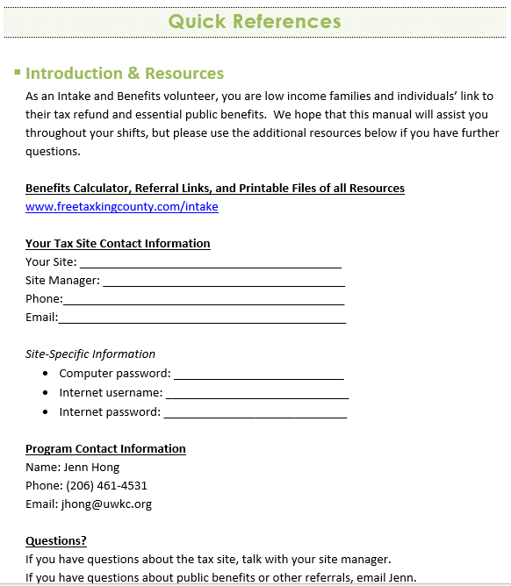
    Intake & Benefits Manual
The first page in your manual is where any site-specific information lives

Slide 27

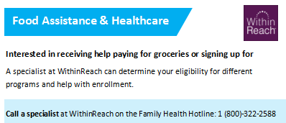
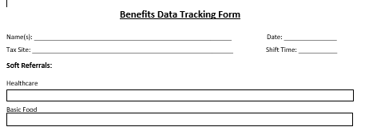
    Intake & Benefits Manual
Referral Sheets
Data Tracking Sheet

Slide 28
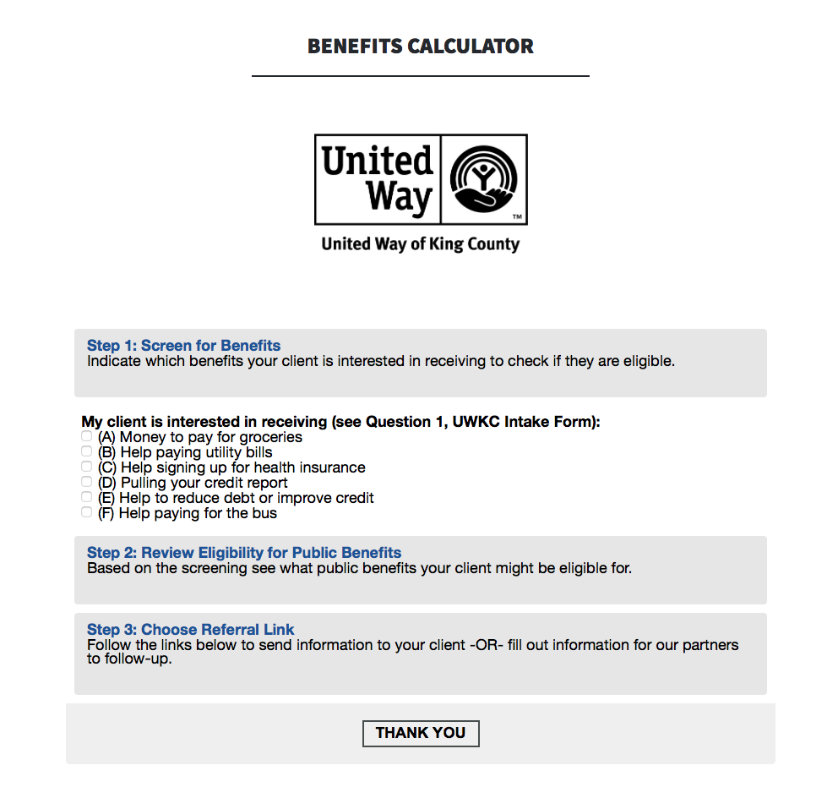
    Benefits Calculator
Your new best friend!

Slide 29
    Benefits Material Bin
Benefits Material Bin
Where you can all referral materials and Benefits Hub resources
  Labeled folders for all Referrals
  Check-In Sheets
  Intake Sheets
  Intake Benefits Manual

Slide 30
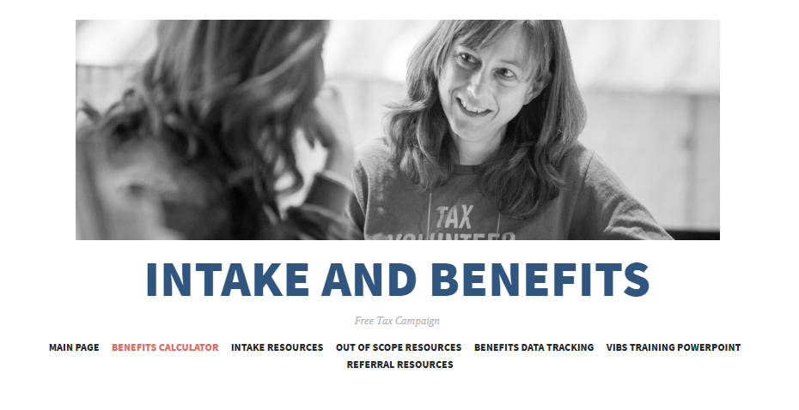
    The Intake Website
FreeTaxKingCounty.com/Intake
  Bookmarked in Browser
  Printable referral forms
  Online Benefits Calculator lives here!

Slide 31
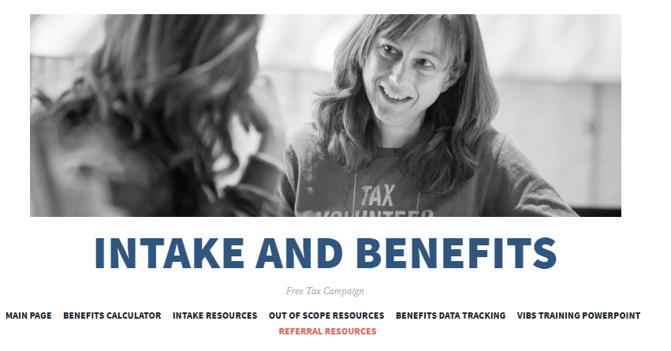
    The Intake Website
Let’s walk through the website now!
www.freetaxkingcounty.com/intake
Notes:
Lee: Stop here and go through the website.
www.freetaxkingcounty.com/intake
Control + to zoom in the website, so everyone can see clearly

Slide 32
    Training Roadmap
Campaign Overview
Resources
Site Operation & Flow
Intake & Screening
Cultural Humility
Standards of Conduct
Benefits: Referrals & Data Tracking
Basic Food & Healthcare
Utility Assistance
Financial Coaching Services
Credit Pulls
Practice & Review

Slide 33
Tax Site Operation
& Flow
    Intake & Benefits Training
Notes:
Lee: This is a deeper dive into your role.

Slide 34
    Intake & Benefit Specialists Role
Intake & Benefit Specialists are critical to site operation & flow.
  Help with tax site set-up
  Greet all clients and is the face of the Free Tax Campaign
  Organize client paperwork
  Pair clients with Volunteer Tax Preparers
  Screen and refer clients for additional benefits
  Maintain site flow

Slide 35
    Site Flow
Anatomy of a Tax Site:
  Intake / Waiting Area
  Tax Preparation Area
  Forms Table
  Administrative Table
1
2
3
4
Notes:
Every task site is different, but they all have these components

Slide 36
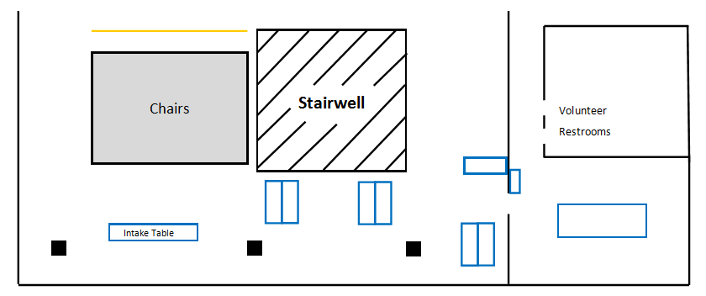
    Anatomy of a Tax Site
Seattle Public Library – Central Branch
3. Forms Table
1. Waiting Area/Intake Area
4. Admin Table
2. Tax Prep Area
Notes:
Lee: The Central Library has two intake volunteers because it’s good. But some sites don’t have intake volunteers yet.

Slide 37
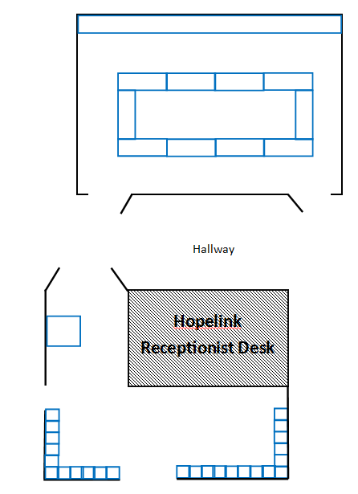
    Anatomy of a Tax Site
3. Forms Table
4. Admin Table
2. Tax Prep Area
Bellevue Hopelink
Intake Table
1. Waiting Area/Intake Area
Chairs
Notes:
Lee: this site has two separate spaces, so sometimes the site manager will be stuck in the back.

Slide 38
    Maintaining Site Flow
Intake & Benefit Specialists are so critical to site flow because:
Many sites have intake and waiting areas that are separate from the tax prep area
  This separation is difficult to manage – with Intake & Benefit Specialists, the site as a whole flows smoothly and effectively
Intake & Benefit Specialists are the face of the tax site and typically the first to interact with clients
Intake & Benefit Specialists answer clients’ questions and redirects more complex tax questions to tax preparers or the site manager

Slide 39
    Where to go on your first day
Class Discussion:
What would you want or need to know for your first day?
Notes:
Find out where the bathroom is, etc.
Meet everyone else at your site
Get familiar with your site manager, like get their phone number! And tell them what snacks you would love to have at the site. Tell them if there are days you know you can’t be there.
Ask your fellow volunteers if there’s anything they want you to tell people as they enter or wait in the lobby.

Slide 40
    First day at the Tax Site
How to get yourself set up for success:
Introduce yourself to your site manager and fellow volunteers.
Set up the intake table with materials from your bin. Use your discretion in how many forms to lay out at once. You’ll learn through experience!
Browse the Intake website and flip through the manual to learn what’s in each section.
Ask your site manager or UWKC staff any lingering or new questions!

Slide 41
Intake Table
    Intake & Benefits Training
Notes:
Show the trainees how the table will be set up using the one onsite.
Hold onto the pens at your table! People tend to walk away with them, and it is very important to have enough pens at the table for new people to fill out their intake forms.

Slide 42
    Intake Table
What makes a successful Intake Table?
Civil Rights poster and Pub 4836
STOP and Services Offered signs
Anything else?
Notes:
Ask trainees what is missing from this slide.
Reminder: On your first day and all other shifts you will be the first to arrive. So you will have time to get comfortable and find a groove in setting up that fits you.
Prize: Whoever sets up the table the quickest/accurate gets a prize. (Giant candy bar as opposed to fun size one?)

Slide 43
    Training Roadmap
Campaign Overview
Resources
Site Operation & Flow
Intake & Screening
Cultural Humility
Standards of Conduct
Benefits: Referrals & Data Tracking
Basic Food & Healthcare
Utility Assistance
Financial Coaching Services
Credit Pulls
Practice & Review

Slide 44
Intake & Screening
    Intake & Benefits Training
Notes:
This is the biggest part of being a VIBS.

Slide 45


    Intake Workflow
Welcome & Signing In
--
Checking for Identification forms
Checking for Scope
  What’s in Scope?
  What’s Out-of-Scope?
  --
Intake Paperwork
  --
Final Check
Notes:
This is the process for how a typical tax site works.
Next, we’ll talk about who runs it, who you’ll be working with, and finally how you fit in as a Intake and Benefits Volunteer

Slide 46

    Welcome & Signing In
Notes:
https://www.youtube.com/watch?v=NhOhvp8OiIk
See, we have designed this intake process intentionally. By asking the client to look at the stop-sign sheet, you are giving them the responsibility because this is their tax return and their life, and so they can choose what to do.

Slide 47
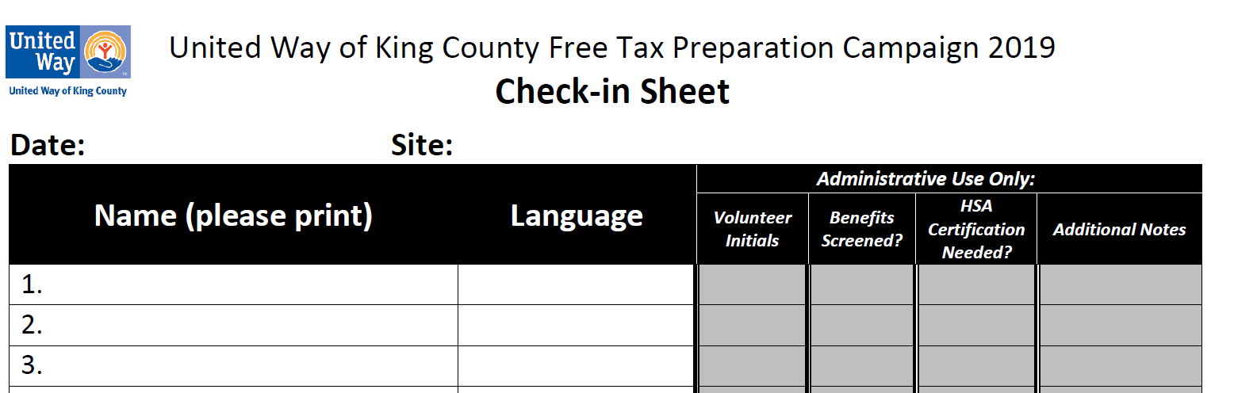
    Welcome & Signing In
  As clients arrive, they should sign in on the check in sheet with their full name and indicate if they have a language need.
  We are a drop-in service – first come, first serve
    Exception: Volunteer language availability may trump the order of clients
  They should not mark anything in the last box
Jenny Walden
Spanish
Notes:
About this boxes in red, “HSA”: Ask clients directly if they have an HSA; if they do have one, they have to have the form, and a special volunteer has to help with that. These volunteers have special certification. So, also find out at your site if you have one of these specialists.
And get familiar to know what languages you have at your site.
Language is the one thing that will trump the order of when clients arrive at the site regarding when they will be seen by a tax specialist.
YOU initial here.

Slide 48
    Intake Workflow
Welcome & Signing In
--
Checking for Identification forms
Checking for Scope
  What’s in Scope?
  What’s Out-of-Scope?
  --
Intake Paperwork
  --
Final Check
Notes:
This is the process for how a typical tax site works.
Next, we’ll talk about who runs it, who you’ll be working with, and finally how you fit in as a Intake and Benefits Volunteer

Slide 49
Intake Paperwork (cont.)
    Identification Forms
Each client is required to have
  A valid Photo ID
  Social Security Cards/Individual Taxpayer Identification Number (ITINS)
Note: If clients have dependents, they need to make sure to have Social Security Cards/ITINs for all people claimed on the tax return.
Notes:
We need two pieces of ID!
Check for valid SS Cards, ITINS or Medicare cards
Medicare Cards have the SSN on them and function as valid ID
If trainees have ITIN questions, tell them we are going to talk about that later.

Slide 50

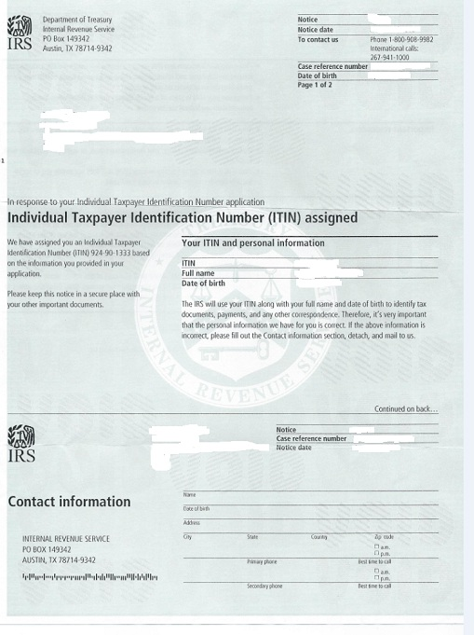
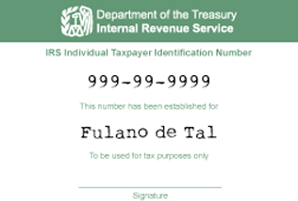
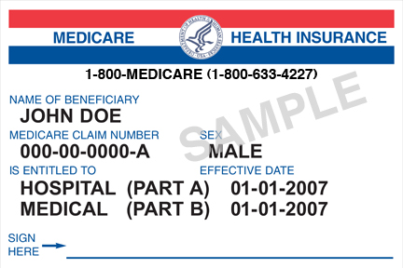
    Valid Forms of ID
ITIN Card/Letter
Social Security Card
Medicare Card with SSN
Notes:
Check for valid SS Cards, ITINS or Medicare cards
Medicare Cards have the SSN on them and function as valid ID
Take the time to explain what an ITIN is
Valid photo IDs include:
Passports
Licenses
VISAs
School IDS
(anything with your picture and info)

Slide 51
    ITINs
ITIN Card/Letter
Q: What is an ITIN?
Individual Taxpayer Identification Number
Issued by the IRS to undocumented or non-citizens
Used for U.S. tax and reporting purposes
Notes:
An Individual Taxpayer Identification Number (ITIN), also known as the W7 form, is a nine-digit number issued by the IRS to certain residents and nonresidents who are required for U.S. tax purposes to have a U.S. taxpayer identification number.
ITINs didn’t used to expire, but they do now. BUT it is not your job to verify that it hasn’t expired; unless you notice, in which case tell the client they will need need to renew, which our tax specialists can help with.
People shouldn’t send in their original document. The VIBS doesn’t have to worry about the certified copy thing; that will be dealt with later.

Slide 52
    ITINs
Clients may come to our sites:
With ITINs
Needing to apply for an ITIN
Needing to renew an ITIN
All of these situations are possible, that will mean neither the ITIN card/letter OR SS Card will be present – that is okay!
ITIN Card/Letter
Notes:
Check for valid SS Cards, ITINS or Medicare cards
Medicare Cards have the SSN on them and function as valid ID
Take the time to explain what an ITIN is
Valid photo IDs include:
Passports
Licenses
VISAs
School IDS
(anything with your picture and info)

Slide 53
        Client Scenario!
Client asks:
I don’t have my Social Security Card with me. Can I use my W-2 to verify my Social Security Number?
NO!
W-2 form is not sufficient because we need a federally issued document!
Notes:
Lead-in question for alternatives of SSC
The Social Security Number can’t be verified on anything else. We need record of their SS# from a federal agency.

Slide 54
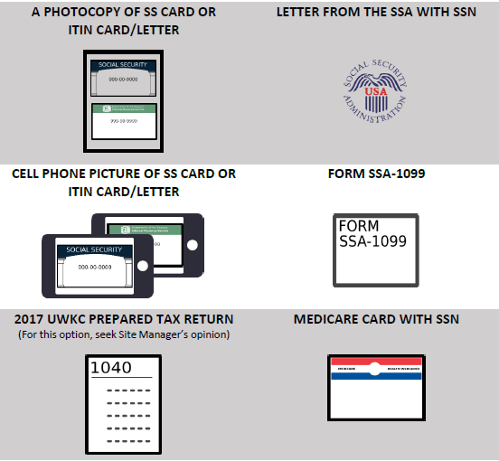
    Alternatives of Social Security Cards
Acceptable alternatives along with a Photo ID
At your site, consult with your Site Manager if needed.
Notes:
Non-government issued tax forms (for example, W-2) are not sufficient to use as acceptable alternatives
This page is in the trainees’ training folders.

Slide 55
    Intake Workflow
Welcome & Signing In
--
Checking for Identification Forms
Checking for Scope
  What’s in Scope?
  What’s Out-of-Scope?
  --
Intake Paperwork
  --
Final Check
Notes:
This is the process for how a typical tax site works.
Next, we’ll talk about who runs it, who you’ll be working with, and finally how you fit in as a Intake and Benefits Volunteer

Slide 56
    Why We Check for Scope
  It is important to check if clients are within the eligibility of our program – known as ‘scope’
Volunteer Tax Preparers are not certified CPAs and therefore cannot prepare all returns that come through the door
Making sure we are preparing returns within the constraints of VITA

Slide 57
    What’s In-Scope?
  What are some common tax forms or tax issues you’re familiar with that we might be able to handle at our tax sites?
Notes:
Don’t show all forms at once, have volunteers list out some common forms they know and put them into columns on the white board

Slide 58

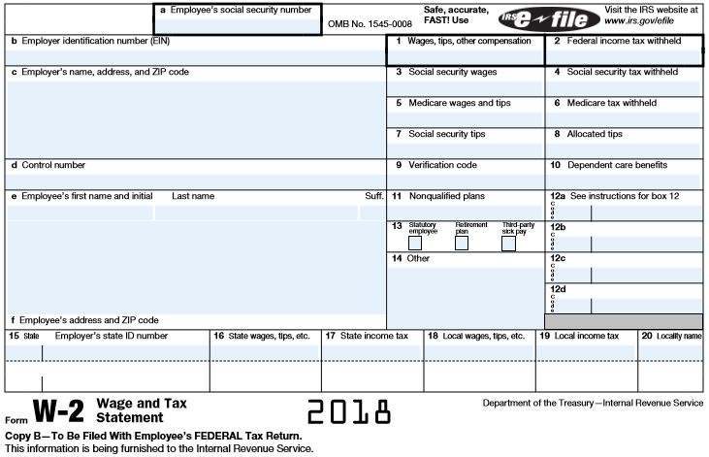
    Common Tax Forms
W-2 Form
Notes:
Don’t show all forms at once, have volunteers list out some common forms they know and put them into columns on the white board

Slide 59
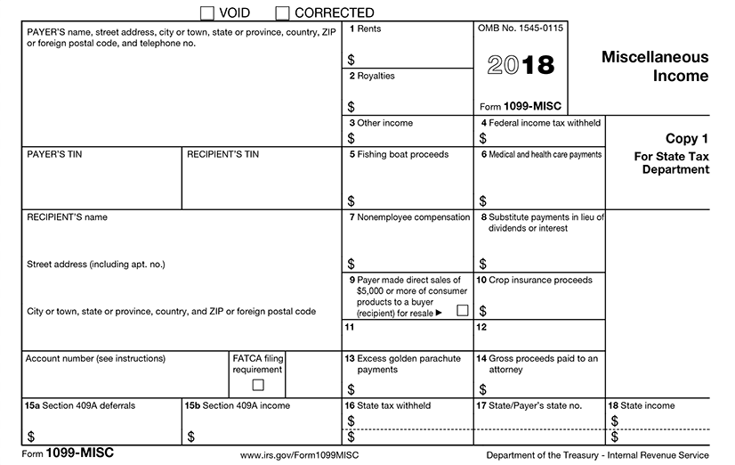
    Common Tax Forms
1099-MISC
Notes:
Don’t show all forms at once, have volunteers list out some common forms they know and put them into columns on the white board
This form is for freelancers, etc.—non-employee compensation

Slide 60
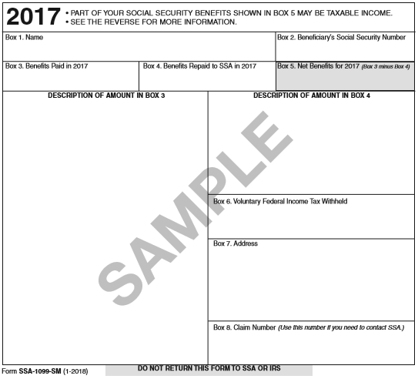
    Common Tax Forms
Form SSA-1099
Notes:
Don’t show all forms at once, have volunteers list out some common forms they know and put them into columns on the white board
This is a benefit statement.

Slide 61
    What’s In-Scope?
  Common tax forms, income, or deductions that are in-scope of our tax volunteer training:
  W-2
  1099-MISC with box 3 or 7 filled
  1099-R (retirement accounts)
  1099-INT or 1099-DIV (interest or dividends)
  1098-T (tuition statements)
  1099-G (unemployment)
  1095-A, -B, or –C
  (Health Insurance Forms)
  Gambling win/loss statements
  Cash Income
  SSA-1099 (social security benefits)
  Small Business Income (including mileage, unreported income/tips, and expenses not exceeding $25,000)
  Mortgage Interest
  Charitable Contributions
  Medical Expenses
  Day care Expenses
  Alimony
  And others…
Consult your Intake Manual first and then your Site Manager if needed!
Notes:
Don’t show all forms at once, have volunteers list out some common forms they know and put them into columns on the white board
It’s easier to go to the next slide/list to see what disqualifies someone.

Slide 62

    What’s Out-of-Scope?
  Common tax forms, income, or deductions we are not equipped to handle (out-of-scope):
  1099-B (Sale of stock or homes)
  Foreclosures
  Business expenses exceeding $25,000
  Net Loss from a business
  Rental Income
  Royalties
  Foreign Income
  1040-NR (non-resident alien)*
  Donation of a car
  Moving Expenses
  In a registered domestic partnership (not the same as same-sex marriage)
  Earned more than $66,000 last year
  Elected Married Filing Separately
  And others…
Consult your Intake Manual first and then your Site Manager if needed!
*Refer clients to UW-VITA site
Notes:
A list like this will be at the intake table with you.

Slide 63

    Is this Form In-Scope?
  In groups of 3 or 4:
  Look through the forms and determine which forms are in-scope, and which forms are out-of-scope.
  If you are confused of a form, set that aside and let’s discuss as group!
Notes:
Prepare envelops that filled with 4 to 5 tax forms and handed these envelops to volunteers

Slide 64
    Is this Form In-Scope?
  Group Debrief:
  Is this form in-scope?
  What other common forms do you know?
Notes:
Prepare envelops that filled with 4 to 5 tax forms and handed these envelops to volunteers

Slide 65
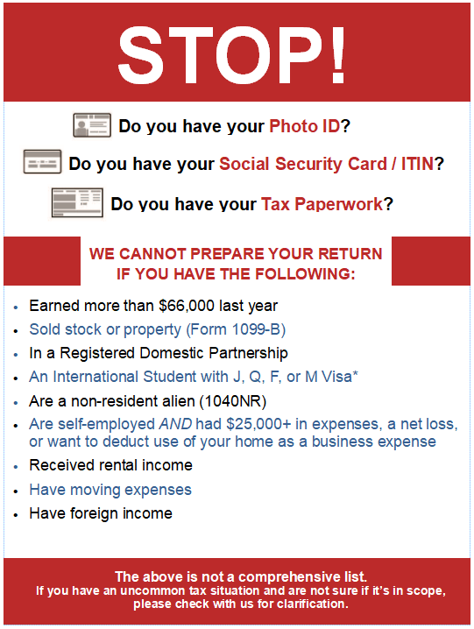
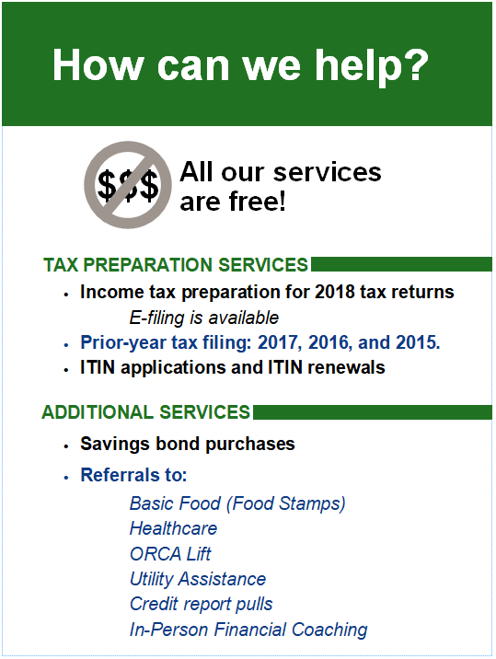
Notes:
A quick resource to direct clients towards
Have clients read over everything and make sure they are within the scope of our program
Clients WILL try to fib and say they read through when they are actually out of scope

Slide 66
    Intake Workflow
Welcome & Signing In
--
Checking for Identification Forms
Checking for Scope
  What’s in Scope?
  What’s Out-of-Scope?
  --
Intake Paperwork
  --
Final Check
Notes:
This is the process for how a typical tax site works.
Next, we’ll talk about who runs it, who you’ll be working with, and finally how you fit in as a Intake and Benefits Volunteer

Slide 67
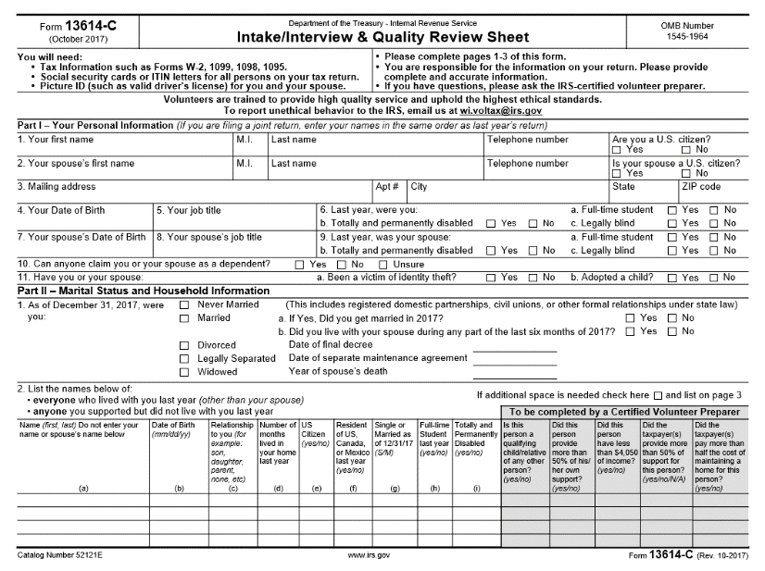
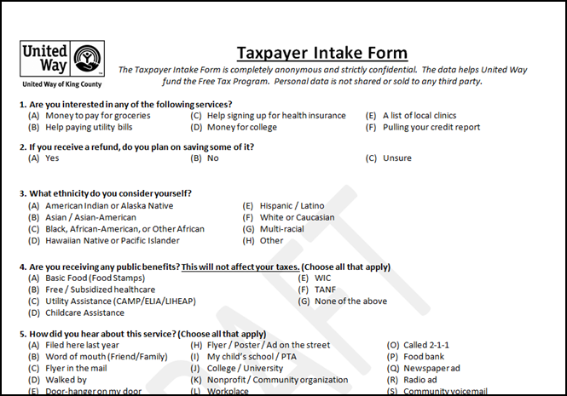

    Intake Paperwork
  There are TWO main forms clients will fill out prior to Tax Prep:
  IRS Intake Form
  UWKC Intake Form and Disclaimer Packet
Notes:
Clients take their intake packet to the waiting area and fill it out.
Remind clients that if they have questions, that they should return to ask you.
Tell clients they must bring their intake packet back up to you when it is completed.

Slide 68
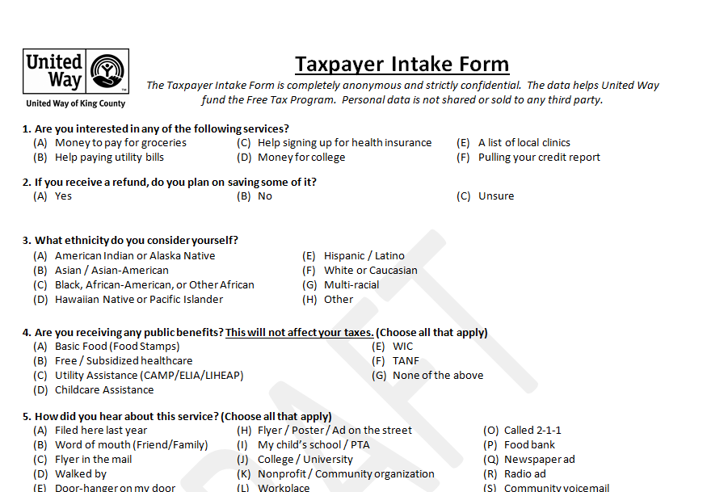
    Intake Paperwork
  UWKC Intake Form and Disclaimer Packet - 4 Pages
  Taxpayer Intake Form – Screen for benefits
  Tax Preparation Disclaimer
  Consent to Use of Tax Return Information
  Consent to Disclose of Tax Return Information
  Consent to Global Carry Forward
Notes:
Note for the trainers: Volunteers should read through the forms together, then you can talk about the purpose of each form.

Slide 69

    Intake Paperwork
  IRS Intake Form
  4 pages long
  Purpose: To aid the volunteer tax preparers in preparing an accurate return
Notes:
Give the volunteers a few minutes to skim through this form and allow a few minutes for questions

Slide 70
    Intake Paperwork
  On your own:
  Let’s take 5-10 minutes and fill out each form.
  Highlight of areas that you find it confusing or might have additional questions.
  We will discuss as a group!
Notes:
Give the volunteers a few minutes to fill out the forms and allow a few minutes for questions

Slide 71
    Intake Paperwork
  Group Discussion – What was confusing?
*Hint: If you found something confusing, chances are a client will too. Discuss any potential pitfalls with your neighbor – especially anything you marked “unsure”.
Notes:
Give the volunteers a few minutes to fill out the forms and allow a few minutes for questions

Slide 72
    Intake Workflow
Welcome & Signing In
--
Checking for Identification Forms
Checking for Scope
  What’s in Scope?
  What’s Out-of-Scope?
  --
Intake Paperwork
  --
Final Check
Notes:
This is the process for how a typical tax site works.

Slide 73
    Final Check
Notes:
https://www.youtube.com/watch?v=x16c21-JNZw

Slide 74
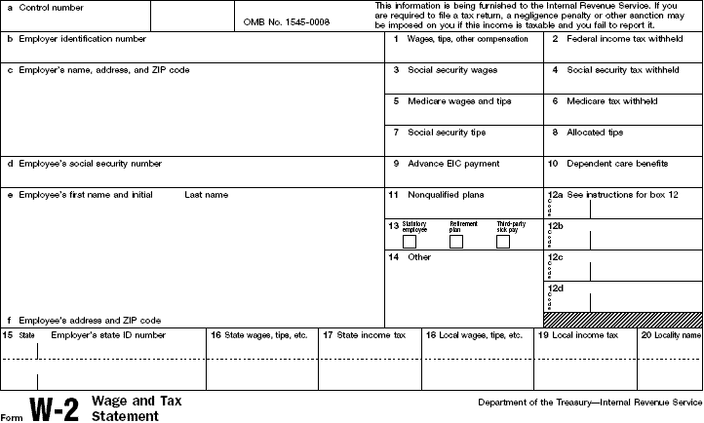
    Final Check
Have the client return to you in order to check over their paperwork and check to make sure they have all their income and tax statements
Most tax forms can be identified in the corner.
Notes:
Ask: What should the client do if the volunteer is out of scope?
Ask: What if the client gets angry?
Also check that the paperwork the client brings in is for 2018. Although, we do tax preparation up to 4 years!

Slide 75
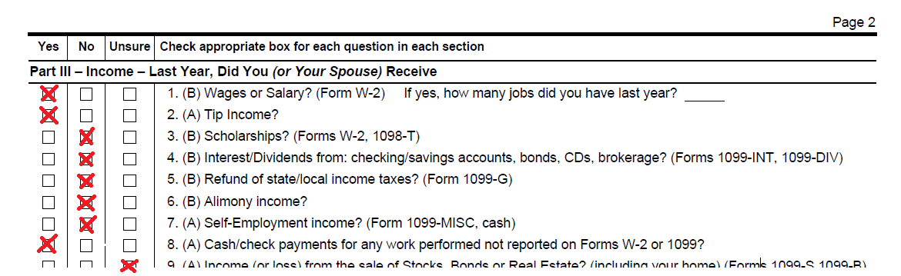
    Final Check
  After client completes intake form…
    …review boxes marked ‘Yes’
      Make sure taxpayer has necessary forms listed for each item
      If any boxes are marked ‘Unsure’ let the client know that the tax preparer will address any of those questions
      Also, review the healthcare coverage section to make sure appropriate boxes are checked
Notes:
The first screening tool you can use is the intake form itself!

Slide 76
    Final Check
Once all the paperwork is complete, keep the IRS Intake Sheet as well as the UWKC Intake Sheet in the order clients are listed
  Instruct clients to keep their photo IDs, SS Cards/ITINS, & tax forms easily accessible
  Let them know that you will be following up while their waiting about different benefits
  If clients are out of scope you can redirect them to the different resources under the “Out of Scope” tab on the Intake Website
Notes:
Ask: What should the client do if the volunteer is out of scope? What if the client gets angry?

Slide 77
    Client Scenario!
  What happens when clients don’t have certain forms?
  Should we keep their intake forms?
Notes:
Ask: What should the client do if the volunteer is out of scope?
Ask: What if the client gets angry?
The answer is, “It depends.” The client should keep the form with them if they haven’t yet seen one of our tax preparers.

Slide 78
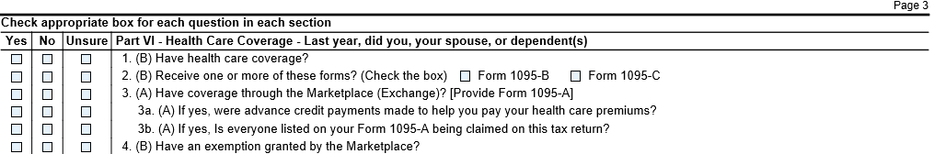
    IRS Intake Form- Health Insurance
Health Care Coverage questions – Page 3 of IRS intake form
Notes:
Walk through the questions and explain why it’s important to clarify these questions with the clients. The next slide will explain the difference of the three health coverage forms.

Slide 79
    IRS Intake Form- Health Insurance
All healthcare forms are required to file taxes.
What’s the difference of health care coverage forms?
Form 1095-A vs. Form 1095-B vs. Form 1095-C
Notes:
The Affordable Health Care Act, also known as Obamacare, introduced three new tax forms relevant to individuals, employers and health insurance providers. They are forms 1095-A, 1095-B and 1095-C. These forms help determine if clients need to comply with the new shared responsibility payment, the fee they might have to pay if they don't have health insurance. For individuals who bought insurance through the health care marketplace, this information will help to determine whether clients are able to receive an additional premium tax credit or have to pay some back.

Slide 80
    IRS Intake Form- Health Insurance
Health Insurance Form | What it means…
Form 1095-A | - Health insurance through the Marketplace (Exchange)
Form 1095-B | - Health coverage through the individual market or a government sponsored plan (example: Apple Health, Medicaid)
Form 1095-C | - Health coverage through the Employer
Notes:
The Affordable Health Care Act, also known as Obamacare, introduced three new tax forms relevant to individuals, employers and health insurance providers. They are forms 1095-A, 1095-B and 1095-C. These forms help determine if clients need to comply with the new shared responsibility payment, the fee they might have to pay if they don't have health insurance. For individuals who bought insurance through the health care marketplace, this information will help to determine whether clients are able to receive an additional premium tax credit or have to pay some back.

Slide 81
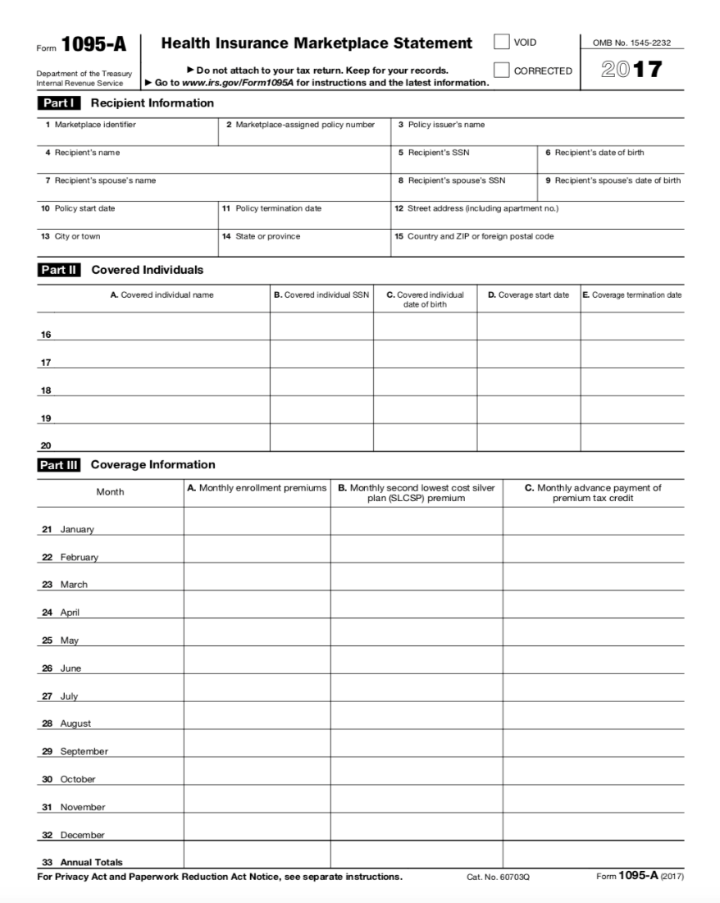
    IRS Intake Form – Form 1095-A
If clients purchase health insurance through the Marketplace,
form 1095-A is REQUIRED to have!
Why?
This form shows important tax credit information necessary for taxes to get processed.
Notes:
Health Insurance Marketplaces furnish this form to:
IRS to report certain information about individuals who enroll in a qualified health plan through the Health Insurance Marketplace.
Individuals to allow them to:
take the premium tax credit,
reconcile the credit on their returns with advance payments of the premium tax credit (advance credit payments), and
file an accurate tax return.

Slide 82
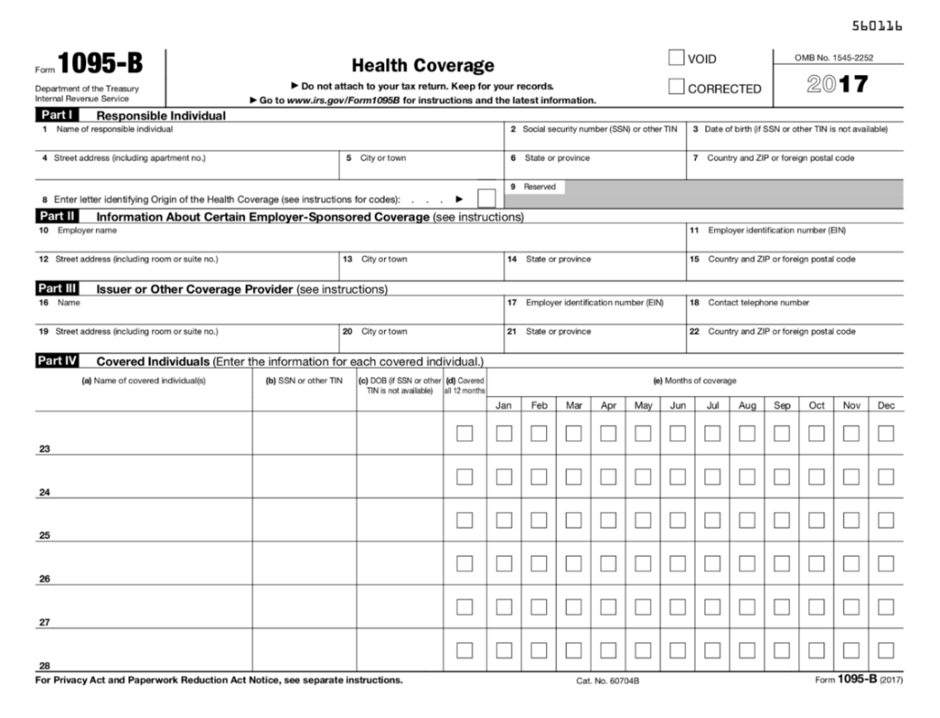
    IRS Intake Form – Form 1095-B
Form 1095-B shows coverage that is provided by an insurance provider or self-insured employer last year. Also the form for Medicaid.
Notes:
Employer with fewer than 50 full-time employees that offer health coverage, as well as health care insurance providers, send the 1095-b form to members of their health insurance plans.
This form includes:
The type of coverage
Your dependents covered
The period of the coverage

Slide 83
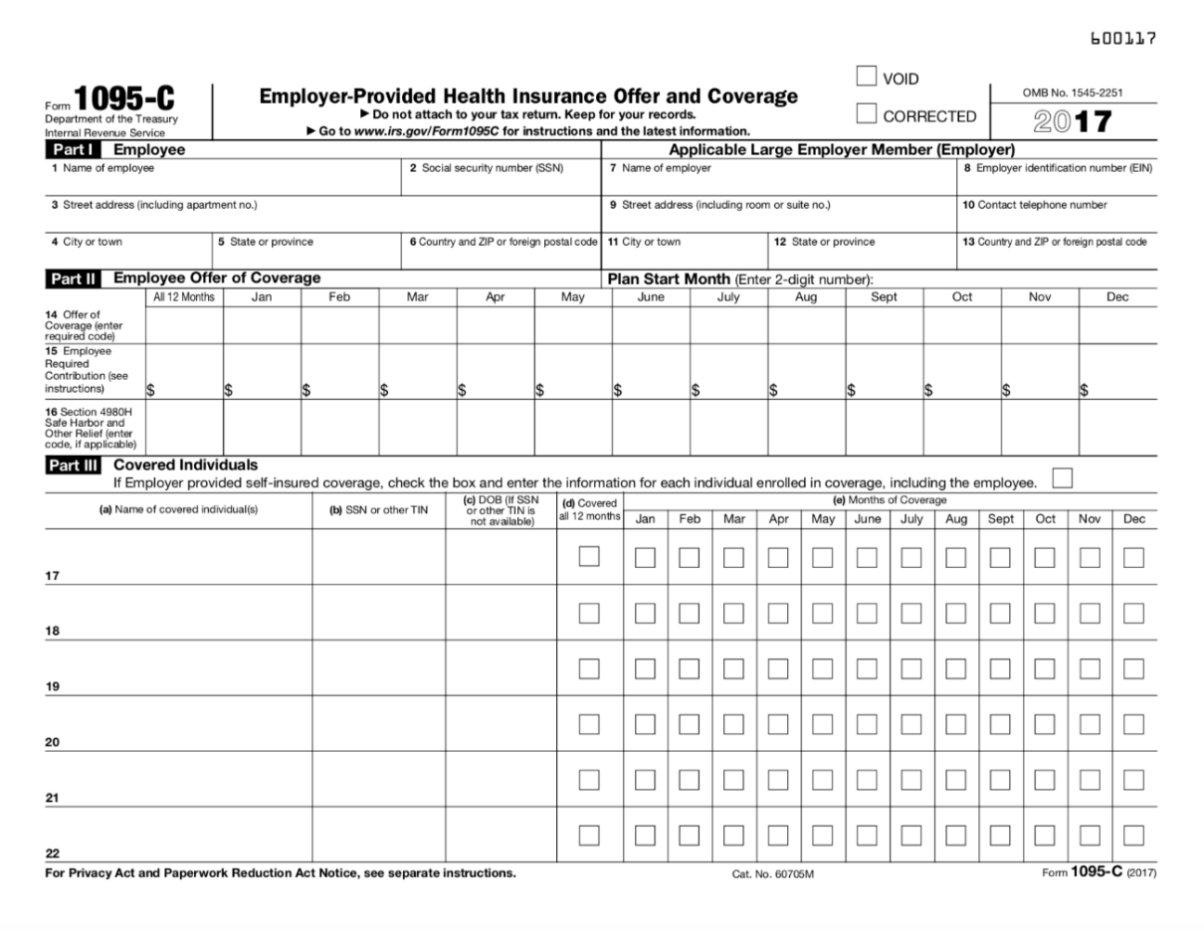
    IRS Intake Form – Form 1095-C
Form 1095-C shows the coverage that is offered by employer.
Notes:
Volunteers can easily search for these forms on IRS.gov website.

Slide 84

    Asking the right questions
If a client checks that they do have health insurance…
What can you ask to best determine which health insurance (and health insurance form) they might have?
Notes:
Volunteers can easily search for these forms on IRS.gov website.

Slide 85
    Asking the right questions
Did client have health insurance last year?
Mark No on Question 1 of Part IV on IRS Intake Sheet
No
Yes
Did client make a monthly payment for your health plan?
No
Client should have received form 1095-B
Yes
Did client receive healthcare through your employer?
No
Client should have received form 1095-A
Yes
Client should have received form 1095-C.
Consult your Site Manager
if needed
Notes:
These slides are available to you on our ewbsite; tell your site manager if you need to look something up on a computer and don’t have one at the table with you.

Slide 86
    Client Scenario:
    IRS Intake Form - Health Insurance
Let’s discuss the following scenario:
Client was enrolled in health insurance through the Marketplace, but they didn’t have the form 1095-A with them.
Can we help complete this return ?
What is the next step?
Notes:
The answer is on the next slide.

Slide 87
    Client Scenario:
    IRS Intake Form - Health Insurance
  1. Can we help complete this return?
Not yet! We can’t complete the tax return right now, because form 1095-A is necessary in this case.
2. What is the next step?
If client has form 1095-A at home, they can either go home to get it or complete as much of the return as possible now until they can return with the form.
b. If the client does not have form 1095-A or haven’t found it yet, they should check their mail or contact Washington HealthPlanFinder to get the form.

Slide 88
Questions?
    Intake & Benefits Training

Slide 89
Review Time!
    Intake & Benefits Training

Slide 90
  Practice Intake Scenario 1
  A married couple wants to file their return
  They both have photo IDs and SSNs
  Their combined income is $55,000
  They have three W-2’s and one 1099-MISC with box 7 filled out.
  They had less than $25k in expenses
  Can they file their tax return at our site?
Notes:
The answer is yes!
The only thing a VIBS needs to answer is whether the client is in scope or not.

Slide 91
  Practice Intake Scenario 2
  A single man wants to file his taxes
  He has an ITIN letter and photo ID
  His income is $22,000 a year
  Can he file their tax return at our site?
Notes:
Yes!

Slide 92
        Pop Quiz!
The IRS given identification numbers for non-citizens/non-resident aliens without a valid Social Security Number are called _______.
Which of the two intake sheet would a single adult male need to fill out?
ITINs (Individual Taxpayer Identification Number)
Both IRS &UWKC
Notes:
False. They should not fill out the tax return level
Both of them– IRS and UWKC

Slide 93
Questions?
    Intake & Benefits Training

Slide 94
    Training Roadmap
Campaign Overview
Resources
Site Operation & Flow
Intake & Screening
Cultural Humility
Standards of Conduct
Benefits: Referrals & Data Tracking
Basic Food & Healthcare
Utility Assistance
Financial Coaching Services
Credit Pulls
Practice & Review

Slide 95
Cultural Humility
    Intake & Benefits Training

Slide 96
Intake/Quality Review Test
    Objectives
Increase understanding of cultural humility
Apply concepts of cultural humility to the tax site & to our Intake & Benefits Specialist role
Identify personal and professional opportunities for growth
Notes:
Make this as quick as possible
Go over introductions
Emphasize you're never alone
Emphasize that we’re still recruiting!

Slide 97
    What is Cultural Humility?
With a partner:
  Have you ever heard of cultural humility before?
  What do you think it is?
  Is it different from cultural competency?
Notes:
“Cultural humility” can also be “cultural awareness.”

Slide 98
    Cultural Humility
A shift from cultural competency
Being aware of our own values, practices & communication styles
Being aware of our own assumptions about human behaviour, our biases, preconceived notions, personal limitations, etc.
Active and on-going engagement with people who are different from ourselves in order to understand their values, practices & communication styles
Developing relevant skills and practices to work effectively in cross-cultural situations
Taking action in order to create a respectful workplace and community
A process, not an end
Notes:
Make this as quick as possible
Go over introductions
Emphasize you're never alone
Emphasize we’re still recruiting!
As humans, we have biases. But we want to work to be aware of our biases. This learning/work is a process, not an end.
Clients are the experts of their own lives. They probably know what they want to do in regard to taxes and benefits.
Think of the tax site as a shared space, sharing the knowledge of our volunteers WITH the knowledge of our clients.

Slide 99

    Cultural Humility & Diversity
What we see, observe, hear, and identify from others:
  Gender presentation
  Estimate of age
  Assumption of race
  Proficiency in our language
  Size
Tip of the Iceberg!
What is invisible without further exploration, relationship-building, and cooperation:
  Nationality
  Sexual orientation
  Religion
  Socioeconomic status
  Level of acculturation
Ethnicity
Politics
Abilities
Relationship to size/ body
Notes:
Make this as quick as possible
Go over introductions
Emphasize you're never alone
Emphasize we’re still recruiting!

Slide 100
    Why it Matters
Systems of Inequality
Poverty is not an individual failing – it is a systemic injustice.
Structural forces embedded in our economic and political systems perpetuate inequality.
Poverty disproportionately impacts those who traditionally experience oppression.
Notes:
Make this as quick as possible
Go over introductions
Emphasize you're never alone
Emphasize we’re still recruiting!
There are a lot of stigmas around poverty.
We are not just talking about black versus white racism.

Slide 101
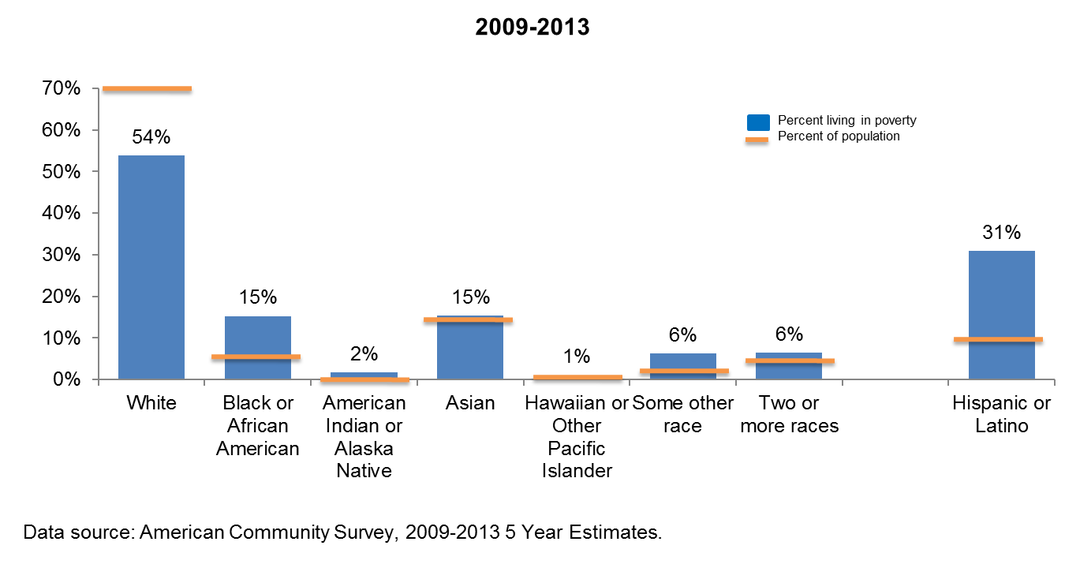
    Why it Matters
Disparities in King County
Notes:
Make this as quick as possible
Go over introductions
Emphasize you're never alone
Emphasize we’re still recruiting!

Slide 102
    Why it Matters
Clients love volunteers
“I had more complex taxes this year than I've had before. The people helping me were very professional and I appreciated the way they treated me. It made the process less scary and helped me get it completely taken care of in less than an hour. Incredible service. I'm so glad that it was available.”
“This free tax service is a real act of kindness for those of us who can't conceive of tackling the forms. I am very grateful as well for the friendliness and competence.”
“I have anxiety regarding forms and financial matters. It is a huge relief to have someone help me with this task. This year, as in years past, a warm, friendly volunteer expertly assisted me with my taxes and filing. I feel very confident using this service and intend to use it every year.”
Notes:
Make this as quick as possible
Go over introductions
Emphasize you're never alone
Emphasize we’re still recruiting!

Slide 103
    Volunteers, Clients, Sites
Client Demographics
  Age range: 16-93
  Living situation: 2% homeless
  100 different languages spoken
  25% lack a checking account
Notes:
Make this as quick as possible
Go over introductions
Emphasize you're never alone
Emphasize we’re still recruiting!
We will have a bank vouchers available.

Slide 104
Intake/Quality Review Test
    Group Exercise
What are some ways that you can practice cultural humility at your site?
Notes:
Make this as quick as possible
Go over introductions
Emphasize you're never alone
Emphasize that we’re still recruiting!

Slide 105
  Cultural Humility at Tax Sites
Our clients are the experts on their own lives and situations.
We hold a body of knowledge that the client may not, but the client also has an understanding outside the scope of ours.
Collaborate and learn from one another.
Avoid advice-giving and judgment.
Notes:
Thoughts
Reactions
Challenges
Why is cultural humility important within the Intake and Benefits role?

Slide 106
Intake/Quality Review Test
    Group Debrief
Thoughts
Reactions
Challenges
Why is cultural humility important within the Intake and Benefits role?

Slide 107
Questions?
    Intake & Benefits Training

Slide 108
    Training Roadmap
Campaign Overview
Resources
Site Operation & Flow
Intake & Screening
Cultural Humility
Standards of Conduct
Benefits: Referrals & Data Tracking
Basic Food & Healthcare
Utility Assistance
Financial Coaching Services
Credit Pulls
Practice & Review

Slide 109
Standards of Conduct & Intake/Quality Review Test
    Intake & Benefits Training
Notes:
Jenn usually does not go through all these slides.
Just read off the slides.

Slide 110
  Volunteer Standards of Conduct
We will go through the Standards of Conduct on a web PowerPoint.
Please open your internet browser and go to:
  www.freetaxkingcounty.com/training
Then on the left side bar, click “Standards of Conduct”
Notes:
Make this as quick as possible
Go over introductions
Emphasize you're never alone
Emphasize we’re still recruiting!

Slide 111
Intake/Quality Review Test
    Intake/Quality Review
Like the Standards of Conduct, this is a test required of all volunteers volunteering at a VITA/TCE site.
Much of the information is not applicable to the Intake and Benefits Process, however, it is important to know the rules of VITA and the roles of the other volunteers.
We will go over the key points of this test together now.
Notes:
Make this as quick as possible
Go over introductions
Emphasize you're never alone
Emphasize we’re still recruiting!

Slide 112
  Intake/Quality Review: Key Points
Key points from the Intake/Quality Review Training:
On the IRS Intake form (form 13614-C) all boxes at the end of the return should be marked either ‘Yes’ or ‘No’ – remember that ‘Unsure boxes will be addressed by the Tax Volunteer
  For every ‘Yes’ answer, make sure there is a corresponding statement if applicable
ALL of our tax returns MUST be Quality Reviewed by another person of the same or higher certification level (regardless of your experience level)
Notes:
Make this as quick as possible
Go over introductions
Emphasize you're never alone
Emphasize we’re still recruiting!

Slide 113
  Intake/Quality Review: Key Points (cont.)
Each Taxpayer MUST provide Photo Identification (and SS Cards/ITINS)
All returns must be signed by the taxpayer after quality reviews and after taxpayer responsibility is explained
  Taxpayers are ultimately responsible for any information provided to the tax preparer
All of the Free Tax Campaign Tax Volunteers are certified to the Advanced level so to ensure all Tax Volunteers can handle all in-scope returns.
Notes:
Make this as quick as possible
Go over introductions
Emphasize you're never alone
Emphasize we’re still recruiting!

Slide 114
  Review – One more time!
Key Point about Question 5
Determine if they clients have form 1095-a or not
Notes:
Make this as quick as possible
Go over introductions
Emphasize you're never alone
Emphasize we’re still recruiting!

Slide 115

    Testing Time!
Now, it’s time to take your tests!
Take 10 to 15 minutes:
Write your Name on the paper tests
Circle the answers on your paper tests
Complete 2 sets of tests:
  Standards of Conducts
  Intake/ Interview & Quality Review
Complete and sign your Volunteer Agreement
Notes:
Make this as quick as possible
Go over introductions
Emphasize you're never alone
Emphasize we’re still recruiting!

Slide 116
  Review – One more time!
Let’s review our answers together and discuss any questions!
Notes:
Make this as quick as possible
Go over introductions
Emphasize you're never alone
Emphasize we’re still recruiting!

Slide 117
Let’s
Lunch!
    Intake & Benefits Training
Notes:
Now we are going to talk about Data tracking, another essential piece of the benefits process.
Lunch is usually around 12 or 12:30. Start again in half an hour or forty-five minutes (1 or 1:15).

Slide 118
    Training Roadmap
Campaign Overview
Resources
Site Operation & Flow
Intake & Screening
Cultural Humility
Standards of Conduct
Benefits: Referrals & Data Tracking
Basic Food & Healthcare
Utility Assistance
Financial Coaching Services
Credit Pulls
Practice & Review

Slide 119
Benefits: Referrals
    Intake & Benefits Training

Slide 120
  What are Public Benefits?
Public benefits are government assistance programs designed to:
  Decrease the hardships of poverty.
  Decrease the hardships of unemployment, illness or disability.
Public benefits exist on federal, state, & local levels.
Notes:
120
Benefits cut the number of Americans living in poverty almost in half.
We are trying to take out the biases of assistance.

Slide 121
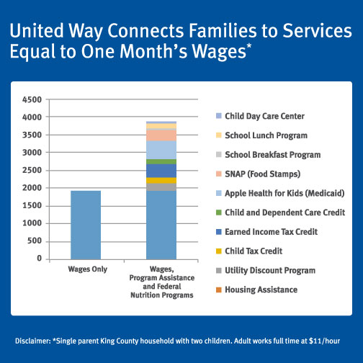
  How much can public benefits help?
An adult earning $11 per hour ($1,833 per month) and caring for two children, could qualify for all these benefits.
Notes:
Check out thecalculator.org !
The column on the right shows how public benefits can increase the income ability of qualifying individuals.
An adult earning $11 per hour ($1,833 per month) caring for her two children could double her monthly income.

Slide 122
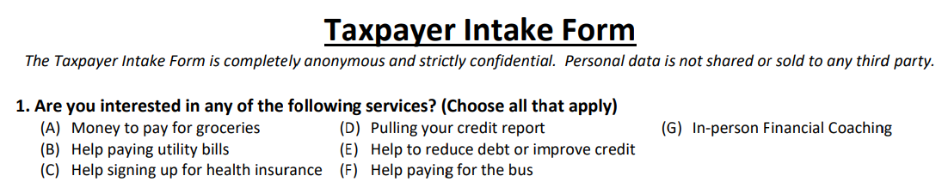
    Determining Benefits
  ALWAYS look at Question #1 on the United Way Intake Form to see what additional services the client marked as interested in.
  Talk to the client about the different benefits opportunities.
  Determine what benefits the client may be eligible to receive.
Notes:
The Taxpayer Intake form will help you determine what benefits clients might be interested in. Although it is still a good idea to talk to clients about how these services can be useful even if they don’t indicate interest.

Slide 123
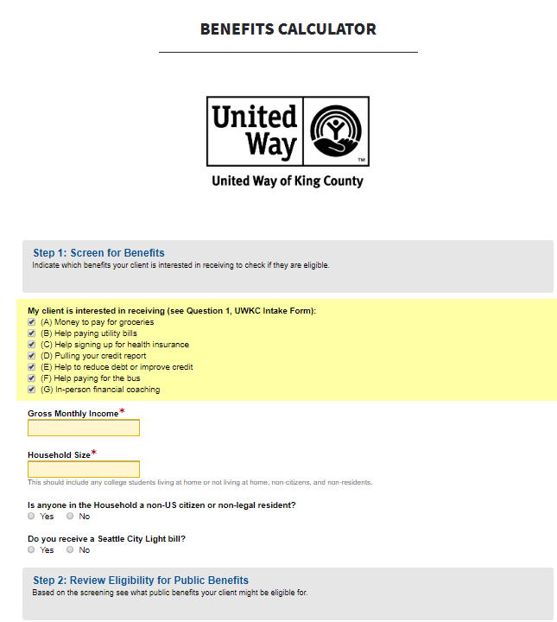
Benefits Calculator
    Benefits Calculator
Use the calculator to find which benefits the client may be eligible for.
Find it at: www.freetaxkingcounty.com/intake
Notes:
The benefits calculator will help you determine what benefits clients are eligible for. In the past we have used paper screeners, and we have those available as back up, but this will streamline the process. When you link from freetaxkingcounty.com to the intake and benefits tab, the calculator will be the first thing that appears. It will also be on the page if you enter freetaxkingcounty.com/intake.
To determine benefits, you will enter the clients income, household size and answer the prompted questions. If anyone in the house is a non-US citizen or non-legal resident, more questions will appear. If the client receives a Seattle City Light bill, another question will appear. The answers to these questions will change the benefits clients may be eligible for.
If for some reason the online calculator is not working, you can screen clients for eligibility for individual benefits in the Intake and Benefits Specialist Manual. These screeners will be under the corresponding tabs. For example, the healthcare eligibility screener will be under the healthcare tab. We will take about these more in the sections discussing these individual benefits.

Slide 124
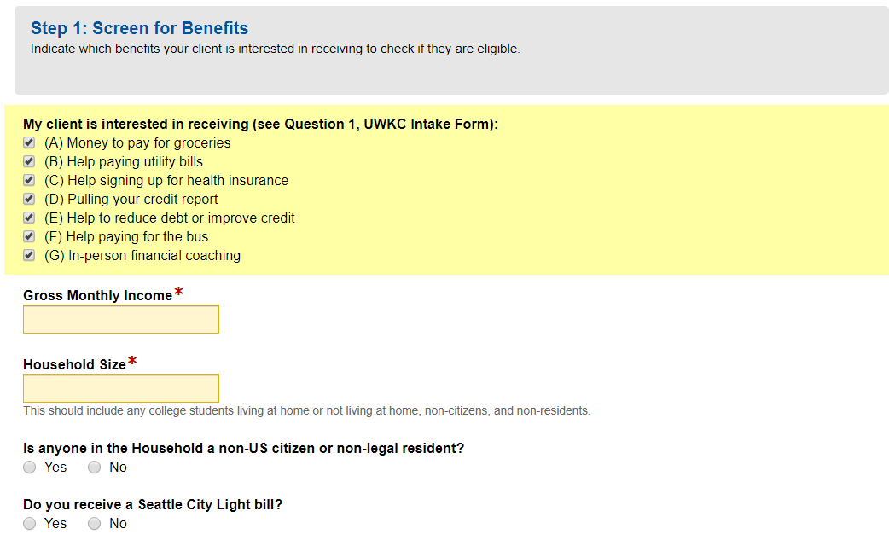
    How does it work?
Step 1: Fill in the client’s income, household size, and more benefit-specific questions.
→The list of benefits that clients may qualify for will appear.
Notes:
Once all the questions are answered, the benefits clients may be eligible for will appear under the public benefits label. Clients will always be eligible for financial counseling and a free credit report pull. If they are eligible for Utility Assistance it may appear under a different name depending on how “Do you receive a Seattle City Light Bill?” is answered.

Slide 125
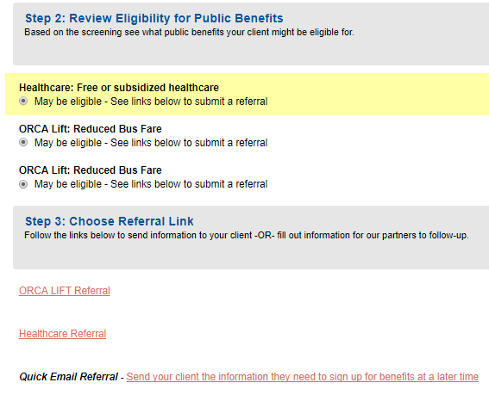

    How does it work?
Steps 2&3: Options for referrals will become available as links.
(We will go over these referrals later today!)
Notes:
Next you will choose your tax site. This will then give you a list of the referral sources.
You can discuss with the client whether they want to do a hard referral or a soft referral. This will depend on the resource and how much time the client is willing to spend. Soft referrals can be given by selecting the “Don’t have time…” link, which will prompt the clients email and benefits interests. You can also give the clients soft referral papers if they don’t want an email or don’t have an email. More information about the different kinds of referral will be given in the next section.
It should be noted that the referral links are general. All of the links will appear once a tax site is chosen, and are not dependent on how the previous questions were answered. The public benefits section will let you know what clients may be eligible for, while the referral links just give you the links to all the benefits. You will have to choose the links that match the clients eligibility.
More information about the specific benefits and using these links to help clients get them will be given later on.

Slide 126
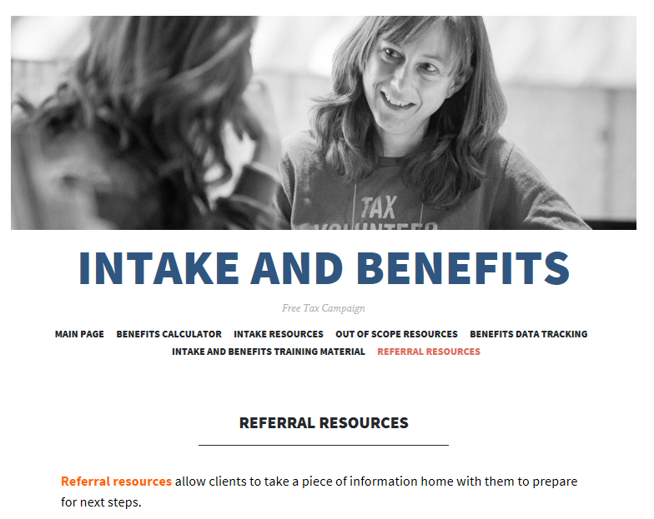
    Other Referral Options
Look under the ‘Referral Resources’ tab on the Intake and Benefits website freetaxkingcounty.com/intake for more information to give clients & printable files of the forms in your Materials Bin.
Notes:
You should be able to reach all the referral information through the Benefits Calculator, but this offers another way to get to these resources.
The dropdown menu will contain all printable files, both paper soft referrals and forms to give clients after you help them with a referral. These are called what to expect sheets and are tailored to the each benefit.
Everything will be on the website!

Slide 127

    Other Referral Options
Let’s walk through the benefits calculator together!
http://www.freetaxkingcounty.com/intake/
Notes:
You should be able to reach all the referral information through the Benefits Calculator, but this offers another way to get to these resources.
The dropdown menu will contain all printable files, both paper soft referrals and forms to give clients after you help them with a referral. These are called what to expect sheets and are tailored to the each benefit.
http://www.freetaxkingcounty.com/intake/

Slide 128
Questions?
    Intake & Benefits Training

Slide 129
Benefits:
Data Tracking
    Intake & Benefits Training
Notes:
Now we are going to talk about Data tracking, another essential piece of the benefits process.

Slide 130
    Benefits: Data Tracking
What Referrals Look Like
  Hard Referrals and Soft Referrals
—
Data Tracking Steps
Paper Data Tracking
-- fasdfasd
Electronic Data Tracking
Know Your Resources

Slide 131
During your shift tally the number of soft referrals and hard referrals you make in the different categories.
    Types of Referrals
Soft Referrals: Provide the client with a flyer or email containing organizations’ contact information.
Hard Referrals: Submit a referral online or pull a credit report. And after, provide a flyer with next step information.
Notes:
For data tracking purposes it is important to know the difference between hard a soft referrals. The benefits calculator provides the link to the soft referral email, although it is also a tab on the website. The calculator link is called “Don't have time to sign up now? Get and email with the information on how to sign up for benefits.” Other soft referral include paper soft referrals, which we have for each individual benefit and are available under printable files on the website. Some of the benefits can only be given as a soft referral, such as LIHEAP.
The hard referral links are all the other links on the benefits calculator. We like to give hard referrals if at all possible because it as more likely that the client will actually be connected to benefits if given a hard referral, and the usefulness of these referrals is easier to track. For the hard referrals, you will have to help clients fill out the online forms, schedule appointments, and pull information, like their credit report.

Slide 132
    Benefits: Data Tracking
What Referrals Look Like
  Hard Referrals and Soft Referrals
—
Data Tracking Steps
Paper Data Tracking
-- fasdfasd
Electronic Data Tracking
Know Your Resources

Slide 133
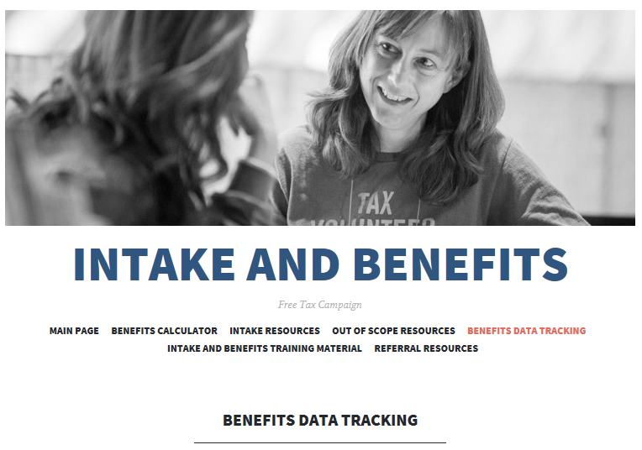
As Intake and Benefits Specialist, you are responsible for tracking the benefits referrals that you make at the tax site.
    Data Tracking
Notes:
As Intake and Benefits volunteers, keeping accurate records of our work through benefits referrals is essential. Here are some of the reasons data tracking is really important. It helps United Way:
Receive continued grant funding
Partner with agencies who support asset building outreach
Use this data to measure the impacts of our work in the community
Identify needed resources
Improve the program for next year

Slide 134
There are 2 steps you will take to track benefits data at the tax site:
    Data Tracking Steps
1. Fill out your Printed Benefits Data Tracking Form during the shift
2. Submit the totals onto the Online Benefits Data Tracking Form
DATA TRACKING IS VERY IMPORTANT in keeping our sites open!
Notes:
The two steps are filling out a paper tracking form and then submitting all that information on the online tracking form which is also on the freetaxkingcounty.com/intake website.
Fill out your Printed Benefits Data Tracking Form before your shift, so you can tally the number of referrals you make.
Submit the totals from the paper form onto the Online Benefits Data Tracking Form at the end or your shift.

Slide 135
    Benefits: Data Tracking
What Referrals Look Like
  Hard Referrals and Soft Referrals
—
Data Tracking Steps
Paper Data Tracking
-- fasdfasd
Electronic Data Tracking
Know Your Resources

Slide 136
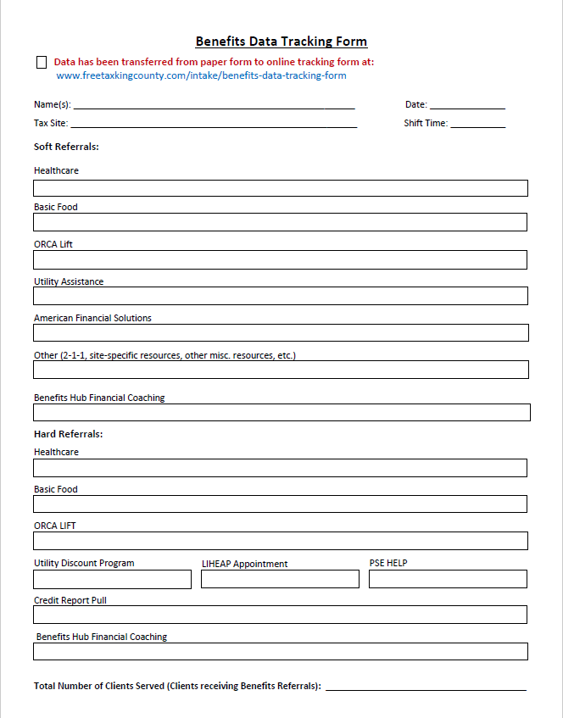
    Data Tracking – Step 1
Paper Data Tracking
Use tallies to keep track of:
all referrals made
total number of clients served
Notes:
This is what the tracking form might look like when it is filled out. Use tallies to keep track of which referrals are given, and the total number of clients served. These may be different if a client is given more than one referral, so make sure you keep track of both.

Slide 137
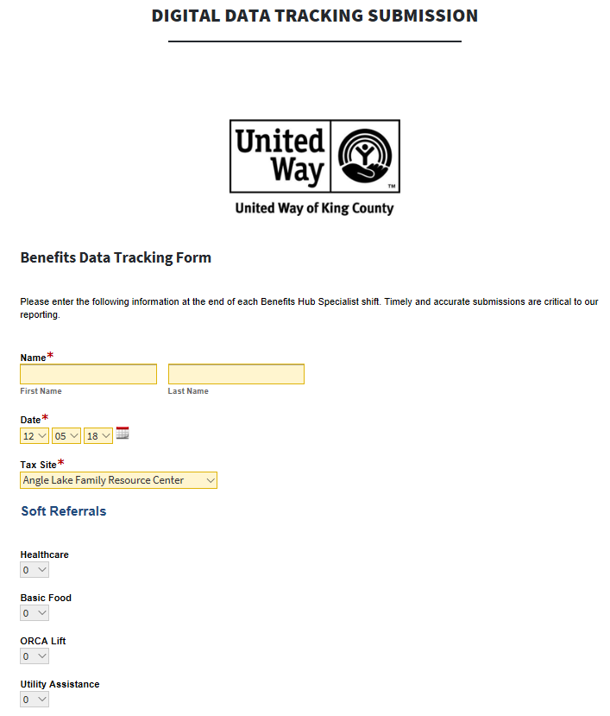
  Data Tracking – Step 2
Digital Submission
At the end of your shift:
Count the referrals made
Transfer the data to the Online Benefits Tracking Form
This way, we identify resources needed and measure our impact for continued funding.
Notes:
Tracking the data is very important in determining how we can best serve our clients. We want to know what they find useful. The online data tracking form is what we use to keep track of all this data. It is essential that you transfer the information from your paper data tracking form to the online form at the end of each shift.

Slide 138
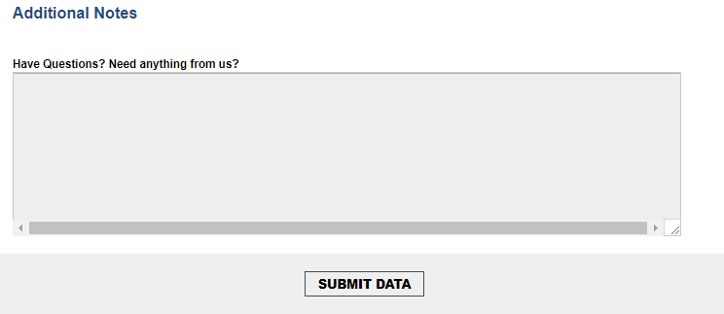
  Data Tracking – Step 2 (cont.)
Additional Notes box for you to share any questions or comments about your data or your shift
Notes:
This is the second part of the online data tracking form. On the website the form will all appear on one page. Remember to fill out the total clients served box. Put any questions or comments you have in the additional notes box. This can be about what you are doing or how you are feeling as a volunteer, or this can be about how you think we can better serve clients with these resources.

Slide 139
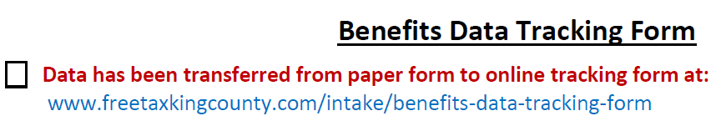

1. Check off the box to indicate that you have submitted your data tracking online
2. Place the completed data tracking form in the Material Bin
  Data Tracking - Step 3
Final Step!
Once you are done transferring your data to the online form ….
Notes:
Just a reminder that both the paper data tracking and online data tracking should be done during your shift. After that is complete you can return your manual to the site manager.

Slide 140
It’s the end of your shift, in what order should you go about closing down your site?
  Tax Site Scenario!
Check the “data has been transferred…” box at the bottom of the paper tracking form
Transfer your referrals from the paper tracking forms to the Digital Data Tracking Submission form
Place all of the paper tracking forms in the Materials Bin
Notes:
Answer: B=>A=>C

Slide 141
  What if there are multiple VIBS at one shift?
How to Data Track:
Submit only one digital submission per shift—we don’t want to duplicate data!
Tip: Designate one person in charge of submitting the online data tracking sheet.
Notes:
Just a reminder that both the paper data tracking and online data tracking should be done during your shift. After that is complete you can return your manual to the site manager.
Designated online submitting person- easiest if same person every shift, but could alternate if deemed desirable.

Slide 142
    Client Scenario!
Take 5 minutes to consider how best to respond to this situation:
A client doesn’t have time for a food assistance hard referral, what other referrals can we make?
Notes:
Answer: Food Assistance Soft Referral sheet or have the client put down their email address for a digital soft referral

Slide 143
    Benefits Data Tracking Quiz
Where can you find the Online Benefits Data Tracking Form?
What are the referrals that are available for people of any income level?

Slide 144
    Benefits Data Tracking Quiz
1. Where can you find the Online Benefits Data Tracking Form?
2. What are the referrals that are available for people of any income level?
www.freetaxkingcounty.com/intake
In-person financial coaching
Credit pulls
Healthcare

Slide 145
    Benefits: Data Tracking
What Referrals Look Like
  Hard Referrals and Soft Referrals
—
Data Tracking Steps
Paper Data Tracking
-- fasdfasd
Electronic Data Tracking
Know Your Resources

Slide 146
Know your resources
  Know your Resources
Resources to help support your work:
Intake and Benefits Manual – Contains more information about specific benefits
FreeTaxKingCounty.com/intake
  Benefits Calculator
  Referral Materials
  Printable Paper Data Tracking Form
  Today’s slides (Review! Review! Review!)
Notes:
These are your main resources. The binder should give you all the information about benefits and will be a resource if the calculator is not working. But for the most part you can be navigating from freetaxkingcounty.com/intake. Remember you can get therefrom freetaxkingcounty.com under the intake and benefits tab.

Slide 147
      Pop Quiz!
What is the difference between a soft referral and a hard referral?
True or False: You only need to fill out your paper data tracking form at the tax site.
What is the maximum salary to be in-scope of our program?

Slide 148
Pop QUIZ!
      Pop Quiz Answers!
What is the difference between a soft referral and a hard referral?
    A soft referral is helping the client sign up for the soft referral email, or giving the client a flyer or phone number to call. A hard referral is submitting the benefit referral online. Both are important to track.
    asdfasd
True or False: You only need to fill out your paper data tracking form at the tax site.
What is the maximum salary for in-scope?

Slide 149
Pop QUIZ!
      Pop Quiz Answers!
What is the difference between a soft referral and a hard referral?
    A soft referral is helping the client sign up for the soft referral email, or giving the client a flyer or phone number to call. A hard referral is submitting the benefit referral online. Both are important to track.
    asdfasd
True or False: You only need to fill out your paper data tracking form at the tax site.
    False. You need to complete BOTH the paper and online data tracking forms.
What is the maximum salary for in-scope?

Slide 150
Pop QUIZ!
      Pop Quiz Answers!
What is the difference between a soft referral and a hard referral?
    A soft referral is helping the client sign up for the soft referral email, or giving the client a flyer or phone number to call. A hard referral is submitting the benefit referral online. Both are important to track.
    asdfasd
True or False: You only need to fill out your paper data tracking form at the tax site.
    False. You need to complete BOTH the paper and online data tracking forms.
What is the maximum salary for in-scope?
  A: $66,000

Slide 151
Questions?
    Intake & Benefits Training

Slide 152
    Training Roadmap
Campaign Overview
Resources
Site Operation & Flow
Intake & Screening
Cultural Humility
Standards of Conduct
Benefits Referrals & Data Tracking
Basic Food & Healthcare
Utility Assistance
Financial Coaching Services
Credit Pulls
Practice & Review

Slide 153
Basic Food, Healthcare, & Transportation
    Intake & Benefits Training
Notes:
Lee: We make referrals in Withreach

Slide 154
WithinREACH Referrals
  --
Basic Food
-
Healthcare
Transportation
Other Resources
Recording Data

Slide 155

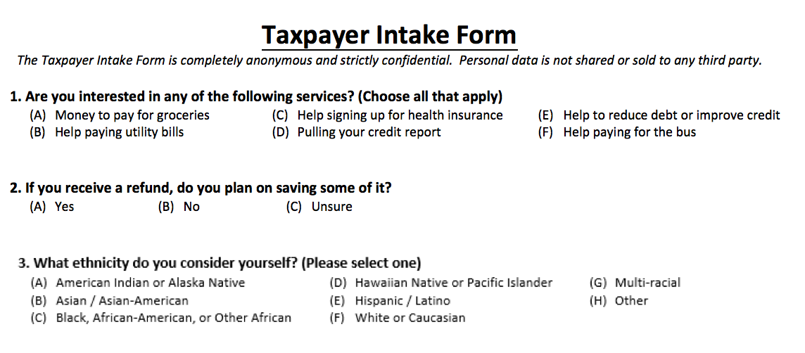
Basic Food
Notes:
This information will be useful if a client is interested in pulling their credit report.

Slide 156
What is Basic Food?
Basic Food is essentially money that can be used to help pay for groceries
Eligibility factors for basic food include:
  Number of people in your household
  Gross monthly income of applicants
  Citizenship/residency status of applicants
Basic Food is also known as SNAP, food assistance, or food stamps.

Slide 157
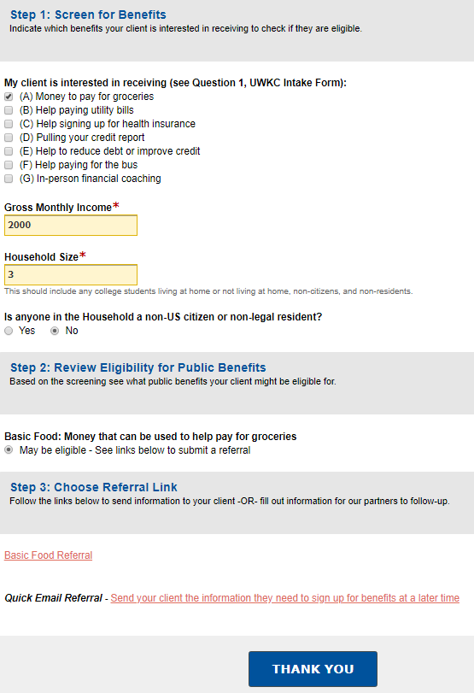
Step 1: Benefits Calculator
Step 1: Enter information into Benefits Calculator

Slide 158

Basic Food: Determinants
Number of people in household
YES, part of applicant’s household | NO, not part of applicant’s household
All people in the household who buy food or prepare meals together | Housemates who do not share food
Applicant’s spouse | Unborn children
Applicant’s child(ren) under age 22 living at the residence (even if the child is married)
Applicant’s parents living in the residence if applicant is under age 22

Slide 159

Basic Food: Determinants
Gross Monthly Income
Income includes:
Income from jobs (include tips, commissions, bonuses)
Self employment income
Social Security
L&I
VA Benefits
Unemployment
Rental income
Child support/ alimony

Slide 160
Basic Food: Determinants
Citizenship status of all household members
YES, eligible | NO, Not Eligible
US Citizen or US National | Non-resident Alien Individuals
Legal Permanent Resident
Cuban or Haitian entrants
Asylees
Refugee
Victim of Trafficking

Slide 161
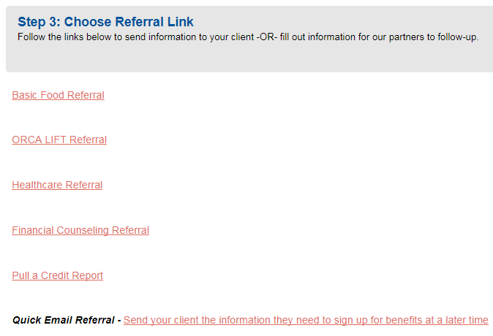
Step 2 – Hard Referral

Slide 162
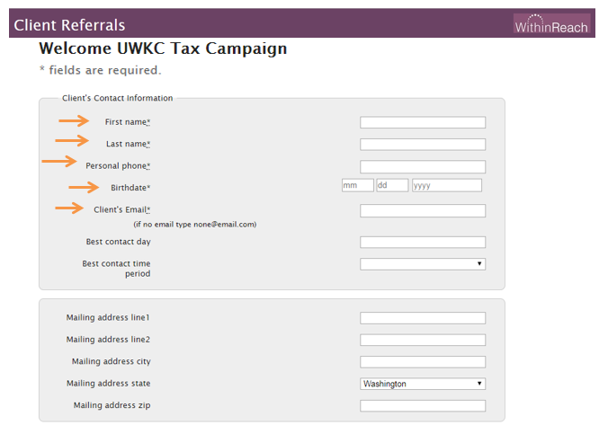
Step 2 – Referral Form
Step 2: Fill out the application on WithinReach’s Client Referrals

Slide 163
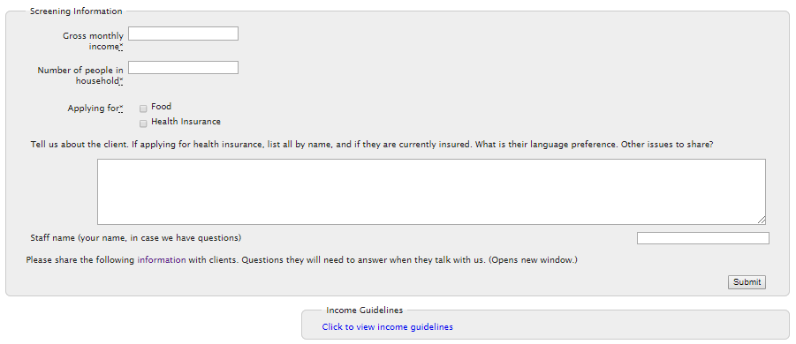
Step 2 – Referral Form
Note: If the client does not speak English, include the language they do speak in the Notes field.

Slide 164
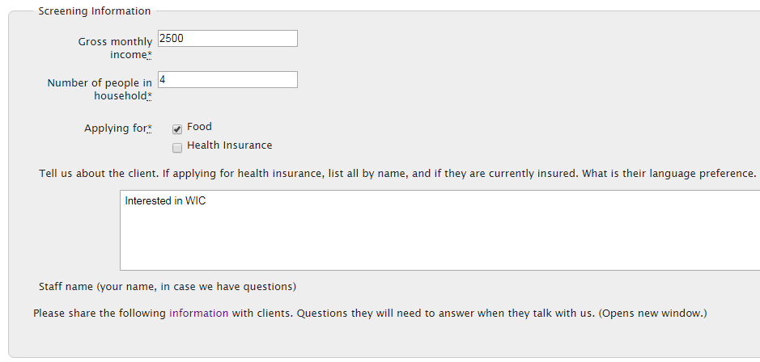
Step 2 – Referral Form
If the applicant is interested in WIC (Food Assistance for Women, Infants, and Children), type “Interested in WIC” in the notes.

Slide 165
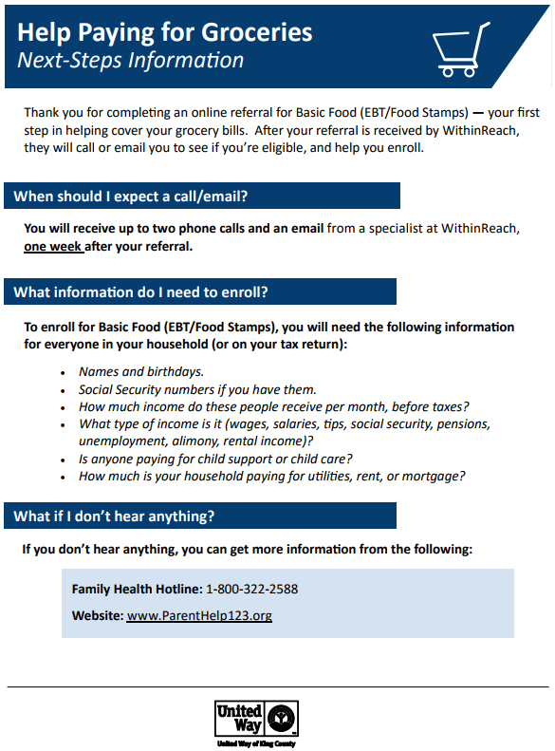
Step 3 – What to Expect
Step 3: Give “Next Steps” sheet to client

Slide 166
Step 3 – What to Expect
After finishing the referral, inform the client:
WithinReach staff members make at least 2 attempts to contact referred clients through:
  Voicemail
  Email
If the client does not hear from WithinReach within 1 week, they should call WithinReach’s Family Health Hotline: 1-800-322-2588

Slide 167
WithinREACH Referrals
  --
Basic Food
-
Healthcare
Transportation
Other Resources
Recording Data

Slide 168

Health Insurance
Notes:
Again, this information will be useful if a client is interested in pulling their credit report.

Slide 169

Health Insurance
Referral Process:
Use Benefits Calculator to screen clients to see if they would likely be eligible for insurance through the Washington State Exchange
Complete WithinReach’s Referral Form
Give clients the Next Steps Sheet

Slide 170
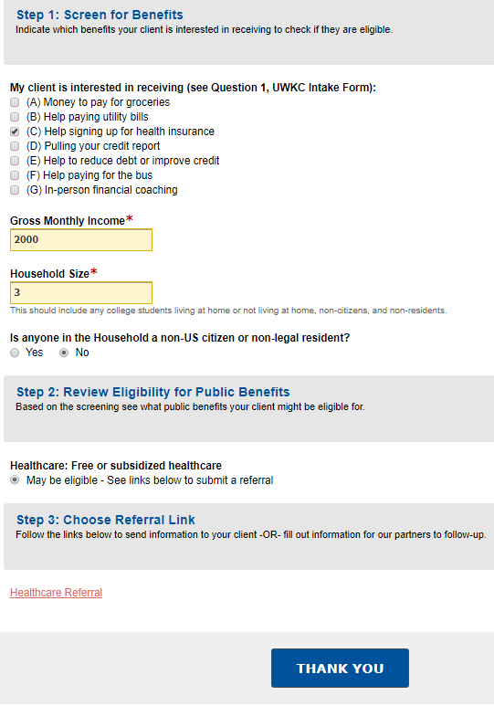
Step 1: Benefits Calculator

Slide 171
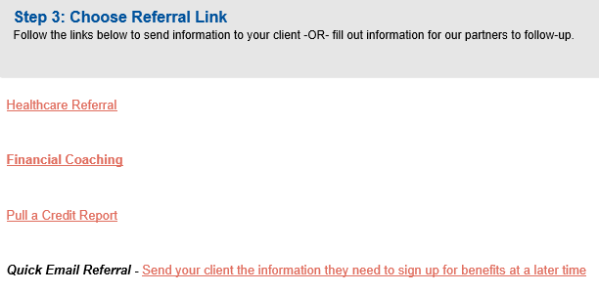
Step 1: Benefits Calculator

Slide 172
Step 2 – Referral Form
Step 2: Fill out the application on WithinReach’s Client Referrals

Slide 173
Step 2 – Referral Form

Slide 174
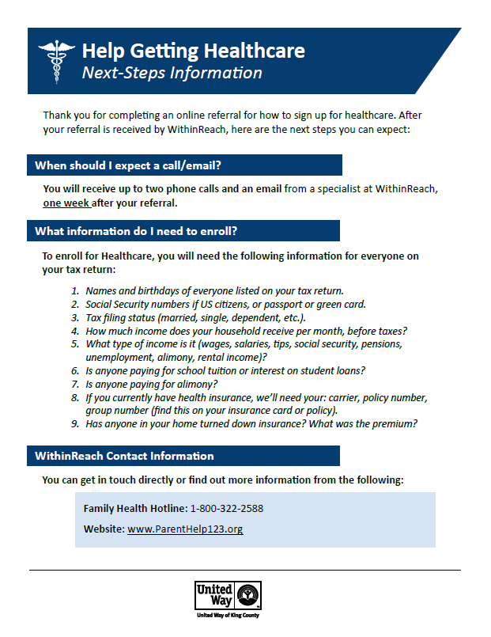
Step 3 – What to Expect
Step 3: Give Next Steps Sheet to clients

Slide 175
WithinREACH Referrals
  --
Basic Food
-
Healthcare
Transportation
Other Resources
Recording Data

Slide 176

Transportation
Notes:
This information will be useful if a client is interested in pulling their credit report.

Slide 177

What is ORCA LIFT?
ORCA LIFT is a reduced fare bus pass for riders with qualifying incomes
With this, bus rides cost $1.50 any time of day (instead of the usual $2.25-2.75)
Functions just like a regular ORCA card

Slide 178
Eligibility for ORCA LIFT
Eligibility factors for ORCA LIFT include:
Income (same as Basic Food)
Age: 19-64
  Riders outside this age range qualify for youth or senior discount passes
There is NO citizenship requirement
Once verified, a client’s eligibility is for up to 2 years, even if income changes.

Slide 179

Step 1: Benefits Calculator
Step 1: Enter information into Benefits Calculator

Slide 180

Step 1: Benefits Calculator

Slide 181
Step 2 – Referral Form

Slide 182

Step 2 – Referral Form
Note: Remember to type “ORCA LIFT” in the notes

Slide 183

Step 3 – What to Expect
Step 3: Give the Next Steps sheet to clients

Slide 184
WithinREACH Referrals
  --
Basic Food
-
Healthcare
Transportation
Other Resources
Recording Data

Slide 185
Other Resources
ParentHelp123.org connects families to:
Health and Food Benefit Programs
Screening families for State programs
Assistance with applying
Resources Online
Search for local services in the Resource Finder
Tool for providers as well

Slide 186

Recording Data: Referrals
Soft Referrals
Hard Referrals
Soft referral email
Soft referral flyer
Submit the Referral Form to WithinReach
Notes:
It is potentially confusing that if you email a resource client it is still a soft referral. But remember it is only a hard referral if you check one of the services on the intake website after using the benefit calculator.
You can delete this slide.

Slide 187
Questions?
    Intake & Benefits Training

Slide 188
    Training Roadmap
Campaign Overview
Resources
Site Operation & Flow
Intake & Screening
Cultural Humility
Standards of Conduct
Benefits Referrals & Data Tracking
Basic Food & Healthcare
Utility Assistance
Financial Coaching Services
Credit Pulls
Practice & Review

Slide 189
Utility
Assistance
    Intake & Benefits Training

Slide 190
Utility Assistance
    Utility Assistance
Notes:
If a client says they are interested in help paying their utility bills, these utility assistance resources will be important.

Slide 191
  Utility Assistance
Utility Programs
  What programs are available and for whom?
  ASDFA
Utility Discount Program
  UDP Eligibility
  Referring clients to UDP
--sDAS
LIHEAP
  Referring clients to LIHEAP
Recording Data

Slide 192
Utility Programs
    Utility Programs
There are two utility assistance programs in King County:
  City of Seattle’s Utility Discount Program → Can lower light bill by 60% and help with past bills.
  The Low Income Energy Assistance Program (LIHEAP) → Can provide up to $1,000/year on utilities.
What programs we refer clients to depends on their utility provider.
Notes:
The program we refer clients to will depend on who their utility provider is. If clients pay utilities to Seattle City light, then we will refer them to the Utility Discount Program. This is a hard referral. It should be noted that not all Seattle City Light customers are residents in the City itself. The customer base extends beyond the city limits.
If clients are not Seattle City Light customers, we will refer them to LIHEAP which stands for Low Income Home Energy Assistance Program. Unfortunately this can only be given as a soft referral.
A clients program eligibility will be determined by how the Seattle City light bill question is answered on the benefits calculator. If the are eligible for UDP this will appear as Seattle Utilities under Public Benefits on the Calculator. Otherwise eligibility will appear as LIHEAP.

Slide 193
Utility Programs
    Utility Programs
UDP vs. LIHEAP
Key Question for determining which referral to give:
Do you have a Seattle City light bill?
YES
If they do have a Seattle City Light bill, then they may be eligible for the Utility Discount Program (UDP).
If they do not have a Seattle City Light bill, but live in King County, then they will be referred to LIHEAP.
NO
Notes:
The program we refer clients to will depend on who their utility provider is. If clients pay utilities to Seattle City light, then we will refer them to the Utility Discount Program. This is a hard referral. It should be noted that not all Seattle City Light customers are residents in the City itself. The customer base extends beyond the city limits.
If clients are not Seattle City Light customers, we will refer them to LIHEAP which stands for Low Income Home Energy Assistance Program. Unfortunately this can only be given as a soft referral.
A clients program eligibility will be determined by how the Seattle City light bill question is answered on the benefits calculator. If the are eligible for UDP this will appear as Seattle Utilities under Public Benefits on the Calculator. Otherwise eligibility will appear as LIHEAP.

Slide 194
  Utility Assistance
Utility Programs
  What programs are available and for whom?
  ASDFA
Utility Discount Program
  UDP Eligibility
  Referring clients to UDP
--sDAS
LIHEAP
  Referring clients to LIHEAP
Recording Data

Slide 195

Utility Programs
  Utility Discount Program
Not just Seattle residents receive Seattle City Light bills:
Shoreline
Lake Forest Park
Part of Burien
Part of SeaTac
Part of Renton
Part of Tukwila
Part of
Normandy Park
Some Unincorporated
King County
(White Center)
Notes:
The Utility Discount Program extends beyond just the City limits. These are all the areas in which individuals can qualify. The red outline shows how far SCL reaches. You should discuss carefully with clients about whether or no they may qualify. UDP is more extensive than programs such as LIHEAP so it will be important to know if clients can take part.

Slide 196

  Benefits Calculator: UDP
Notes:
If you click on the link to the Seattle Utility Assistance Referral from the benefits calculator, this page will open. It is considered a hard referral. Under the name section, make sure to enter the name of the Seattle City Light account.
You can also link to this page from the freetaxkingcounty.com/intake website under the referral sources tab.

Slide 197

  UDP Hard Referral Form
Clients can fill out the form to have a UDP employee follow up with them in 3-5 weeks.
Notes:
If you click on the link to the Seattle Utility Assistance Referral from the benefits calculator, this page will open. It is considered a hard referral. Under the name section, make sure to enter the name of the Seattle City Light account. You can also link to this page from the freetaxkingcounty.com/intake website under the referral sources tab.
Link to the UDP hard referral form is from in the Benefits Calculator.
Clients can fill out the form to have a UDP employee follow up in 3-5 weeks.

Slide 198


    UDP Materials
Next Steps-
Hard Referral Sheet
Soft Referral Sheet
Notes:
Once you and the client fill out the referral information, you can give them a What to Expect sheet, which will tell them about what they should expect in terms of follow up, and what they need to have ready to get access to the benefits. The UDP has a What to Expect sheet and a FAQ sheet. Again this available on the freetaxkingcounty.com/intake website under the printable files tab.
UDP Next Steps Sheet
Give to clients after submitting the online UDP hard referral.
Help Paying Utility Bills Sheet
UDP, LIHEAP, and 2-1-1 are all listed. Mark which benefit the client might be eligible to receive.
Again, you may be emailing the soft referral sheet, but that is still considered a soft referral.

Slide 199
  Utility Assistance
Utility Programs
  What programs are available and for whom?
  ASDFA
Utility Discount Program
  UDP Eligibility
  Referring clients to UDP
--sDAS
LIHEAP
  Referring clients to LIHEAP
Recording Data

Slide 200

  Benefits Calculator: LIHEAP
Notes:
If clients are not Seattle City Light customers, we will refer them to LIHEAP which stands for Low Income Home Energy Assistance Program. Unfortunately this can only be given as a soft referral.
You can also link to this page from the freetaxkingcounty.com/intake website under the referral sources tab.

Slide 201

  Setting Up LIHEAP Appointment
If residents do not receive a Seattle City Light bill, they may be eligible for the Low Income Home Energy Assistance Program (LIHEAP).
Website and phone number vary by area of residence:
Notes:
If clients are not Seattle City Light customers, we will refer them to LIHEAP which stands for Low Income Home Energy Assistance Program. Unfortunately this can only be given as a soft referral.
You can also link to this page from the freetaxkingcounty.com/intake website under the referral sources tab.

Slide 202

    LIHEAP - Hard Referral
We can give clients the hard referral flyer after the appointment is set up.
Notes:
LIHEAP does not provide an option for hard referrals.

Slide 203

    LIHEAP - Soft Referral
If the client doesn’t want to sign up for an appointment on the spot, we can give clients the soft referral flyer or send a soft referral email.
Notes:
LIHEAP does not provide an option for hard referrals.

Slide 204
  Utility Assistance
Utility Programs
  What programs are available and for whom?
  ASDFA
Utility Discount Program
  UDP Eligibility
  Referring clients to UDP
--sDAS
LIHEAP
  Referring clients to LIHEAP
Recording Data

Slide 205
Recording Data: Referrals
Soft Referrals
Hard Referrals
Soft referral emails (UDP or LIHEAP)
Energy Assistance Programs flyer (UDP, LIHEAP, 2-1-1)
2-1-1 business cards
Online UDP form submitted + UDP Next Steps Half-Page
LIHAEP Appointment

Slide 206
  Utility Assistance Scenario 1
Pull up www.freetaxkingcounty.com/intake
Use the Benefits Calculator
Family of 5 lives in Bellevue:
  Single parent with 3 children (under 18) and one adult child
  They don’t receive a Seattle City Light Bill
  Monthly income is $2500
What Utility Assistance hard referral would we make?
Notes:
We are going to try a scenario to see if we can determine what utility benefits this client may qualify for.
Lee: You will refer them to Bellevue Hopelink

Slide 207
  Game Time: Let’s track our data!
Game Rules:
Keep an eye out for slides with orange banners at the top, as you’ll be asked to tally a referral on each on
We’ll go over the final count at the end of the presentation, so stay on your toes
We just made a referral to LIHEAP!
Notes:
We are going to try a scenario to see if we can determine what utility benefits this client may qualify for.

Slide 208
  Pop Quiz
What form and question do you look at to begin the benefits calculator?
True or False: We are a drop-in service and nothing else trumps first come, first served.
A: United Way’s Intake Form- Question #1
  False! We are drop-in and usually first come-first served… but language need trumps this order.

Slide 209
Questions?
    Intake & Benefits Training

Slide 210
    Training Roadmap
Campaign Overview
Resources
Site Operation & Flow
Intake & Screening
Cultural Humility
Standards of Conduct
Benefits Referrals & Data Tracking
Basic Food & Healthcare
Utility Assistance
Financial Coaching Services
Credit Pulls
Practice & Review

Slide 211
In-Person Financial Coaching
    Intake & Benefits Training

Slide 212
    Financial Coaching
Financial coaching appointments can cover the following topics:
  Credit reports
  Savings accounts and retirement plans
  Investing
  Decreasing debt
  And others…
In general, financial coaching appointments can be a time when clients talk through personal financial situations.

Slide 213

    Financial Coaching
Let’s go through the website!
https://www.uwkc.org/benefitshub/
Notes:
Using the map clients can find the Benefits Hub location nearest to them.

Slide 214


    Step 1- Selecting Location
Ask client to select preferred location.
Refer them to the map to find the closest site.
Notes:
Using the map clients can find the Benefits Hub location nearest to them.

Slide 215

    Step 2 - Selecting Day
Client can select their preferred appointment date
Available dates are listed up to two weeks in advance

Slide 216


    Step 3 - Selecting Time
Clients can select desired time on that day
Assist the client in choosing an hour time slot for the appointment.
Then press ‘book it.’

Slide 217

  Step 4 - Entering Personal Information
Fill out clients’ information, including:
Contact information
Reason for appointment
If text reminders are permissible
Make sure to select your tax prep site!

Slide 218

    Final Step - Next Steps Sheet
After the appointment is made…
Fill out your current tax site where the appointment was made
2. Input the client’s appointment information
Notes:
Using the map clients can find the Benefits Hub location nearest to them.

Slide 219
Client Scenario – Financial Coaching Appt.
We just signed someone up for a financial coaching appointment….
Mark this down on your data tracking sheet!

Slide 220
    Client Scenario
If a client tells you they’re more interested in talking to financial coach over the phone, we have a referral for what?
Refer them to American Financial Solutions.
Notes:
Using the map clients can find the Benefits Hub location nearest to them.

Slide 221

  American Financial Solutions
American Financial Solutions is a nonprofit financial education and credit counseling agency.
Their representatives can pull credit reports and discuss the results with clients.
We will have resource booklets from them at each tax site – we don’t have many per-site, but please make them available for clients to read while waiting.
Notes:
American Financial Solutions has a mission of empowering people to improve the quality of their lives through financial education and credit counseling. Their focus is on asset building through structured debt reduction, budgeting and goal setting.
We can refer clients to them if they want to work with someone to understand what their credit report means, or they want to learn how to better manage their finances to improve their credit report.

Slide 222
  American Financial Solutions
What clients can expect from calling AFS:
A financial counselor will talk with clients about their financial situation.
Counselors can do soft pulls of credit reports AND credit scores
    These will not affect the client’s credit as they are soft inquiries.
Counselors can offer advice and debt solutions.
Notes:
American Financial Solutions has a mission of empowering people to improve the quality of their lives through financial education and credit counseling. Their focus is on asset building through structured debt reduction, budgeting and goal setting.
We can refer clients to them if they want to work with someone to understand what their credit report means, or they want to learn how to better manage their finances to improve their credit report.

Slide 223
Client Scenario – American Financial Solution
We just gave a client more information about American Financial Solutions….
Don’t forget to mark this down on your data tracking sheet!

Slide 224
Recording Data: Referrals
Soft Referrals
Hard Referrals
Soft referral email for Benefits Hub or AFS
Soft referral flyers for Benefits Hub or AFS
AFS business card
Financial Coaching appointment

Slide 225
    Training Roadmap
Campaign Overview
Resources
Site Operation & Flow
Intake & Screening
Cultural Humility
Standards of Conduct
Benefits Referrals & Data Tracking
Basic Food & Healthcare
Utility Assistance
Financial Coaching Services
Credit Pulls
Practice & Review

Slide 226
Credit Pulls
    Intake & Benefits Training

Slide 227
Credit Pulls
  --
Credit Reports
-
Why Review Credit Reports
How to Pull a Credit Report
Alternative options - Financial Coaching
Recording Data

Slide 228
          Credit Pulls
Notes:
This information will be useful if a client is interested in pulling their credit report.

Slide 229

Credit Reports
Credit Reports are a record of your credit history.
There are three National Credit Bureaus who produce your credit report:
  Equifax
  TransUnion
  Experian
Who looks at your credit report?
  Potential lenders, merchants, & landlords.
How frequently can I view my credit report?
  The Fair and Accurate Credit Transaction Act (FACT) allows you to review your credit reports
  (all three) once per year for free.
Notes:
So what is a credit Report? It is a record of your borrowing and repayment history. It contains information about how you pay your bills and it represents your ability to manage your credit and debt. Ultimately is used to determine your overall risk to a lender.
There are 3 major credit bureaus who compile information on individuals and their credit usage. Equifax, TransUnion and Experian. They work independently and structure their reports slightly differently from one another.
Credit Reports can be reviewed by others such as potential lenders, merchants, landlords, and employers. It can be used to make determinations on issuing you a loan and other purposes allowed by the Fair Credit Reporting Act.
Another Act, the Fair and Accurate Credit Transactions Act, allows you to obtain one free credit report from each of the major credit bureaus once per year that is a rolling 365 day period, not a calendar year. There are a few other occasions allowed to request a free credit report directly from the CRA, such as being denied credit, denied employment or insurance, suspected fraudulent use of your accounts, however you will have to provide the credit bureaus with proof of any of these situations and this can be quite complicated. Otherwise, there is a charge for any additional reports. Also there is a charge to obtain your credit score, about 10.00, charged by each Bureau.
So when we are helping clients pull their credit report, we are helping them get this information.

Slide 230
Credit Pull, AFS, Benefits Hubs
  --
Credit Reports
-
Why Review Credit Reports
How to Pull a Credit Report
Benefits Hub- Financial Coaching
Recording Data

Slide 231
  Why Review Credit Reports?
To identify inaccurate data
To know your borrowing power
To reveal attempts to steal your identity
To see who else has been looking at your credit
Notes:
This is information that you can give the clients about why they might want to view their credit report. Here are 4 key reasons to review your report:
Mistakes happen and there may be errors that are having a negative effect on your credit or even affect your ability to obtain credit.
The status of your credit may be a factor in determining the interest rate that a bank or mortgage company will charge you for your loan and in determining whether your loan will even be approved. You do not want to discover this at the time of purchase and trying to secure a loan for a car or home.
Identify theft is the fastest growing white collar crime in America today. Reviewing your report allows you to immediately follow up on any unusual items you find on your report. If suspicious items appear on the report, you can place a fraud alert on your file with each of the three credit bureaus.
Also, you should know who has been looking at your credit report. Companies can make inquiries to either review your credit status or to evaluate you as a candidate for promoting their products to you.
These are reasons you may want to remember so you can explain the significance of credit report pulls to clients.

Slide 232
Credit Pull, AFS, Benefits Hubs
  --
Credit Reports
-
Why Review Credit Reports
How to Pull a Credit Report
Benefits Hub- Financial Coaching
Recording Data

Slide 233




  Methods for Later Credit Pulls
A. Online
C. By Mail
Annual Credit Report Request Service
PO Box 105281
Atlanta, GA 30348-5281
B. Over the Phone
Call 877-322-8228
D. In-person Financial Coaching

Slide 234



  Requesting Credit Reports - Online
Using the Benefit Calculator, and mark client is interested in pulling a credit report
A referral link to the following site will be listed:
https://www.annualcreditreport.com
Notes:
You can tell clients that there are several ways to get their credit report. It is available online and viewable immediately or by phone or through the mail and will be processed within 15 days of receiving the request.

Slide 235
  Requesting Credit Reports- Online
From there, it’s a 3-step process:
Enter specific required data
Answer questions to confirm clients’ identify
Clients review their report
Notes:
You can tell clients that there are several ways to get their credit report. It is available online and viewable immediately or by phone or through the mail and will be processed within 15 days of receiving the request.
https://www.annualcreditreport.com

Slide 236
  Requesting Credit Reports- Mail
If the AnnualCreditReport site is temporarily down:
Request by mail
Refer client to visit in-person Financial Coach
Client can call American Financial Solutions
Notes:
If the client doesn’t what to get their report online, there is a form for requesting their credit report by mail. This is also what they will use if they answer the security questions incorrectly.

Slide 237
Client Scenario - Credit Report Pull!
A client just requested you pull their credit report.
You pulled it and reviewed it with the client.
→ Put a tally down for credit pull on your data tracking sheet.

Slide 238

  Soft Referral - Materials
For credit pulls – provide flyer for AFS and Benefits Hub, who can pull reports.
Plus hand out AFS business cards – found in your Benefits Hub Bins
Notes:
After helping the client get their credit report, you can give the client information on who they can talk to about their report. You should have available a sheet titled “Who can you talk to about your credit report?” We recommend clients contact American Financial Solutions or the Financial Empowerment Center.

Slide 239

  Soft Referral Email
Client can receive Benefits Hub and AFS information via the soft referral email:
Notes:
Once on the site, you will have a start here to view and print your credit report now, select your state and hit request report. You will then have to enter personal information, SSN will be encrypted for protection and you can check the box if so only the 4 last digits to show on the report. You can choose which bureau, or all three if you wish, to obtain a current credit report. When you click next you will be transferred to the Bureau site and then prompted to answer about 4 verification questions that are based on information in your file and only the client should know the answers to.
If the client does not pass the security questions, they can opt to mail in for your credit report.
You can have the client fill out this information his/herself.
It is important to have immediate access to this information that the credit bureau needs in order to identify you. These security questions are multiple choice including non of the above. The questions typically ask about previous names, previous addresses, names of banks or credit cards that you have had in the past or the amount of the payments.
The credit report will contain 5 sections
The Personal information section that includes names, address, previous address, DOB, SSN, Phone and a file number. All of this information should be reviewed for accuracy. The file number is important to note and will be used to reference in the event of making any corrections to the report.
The Account history- This section provides information either in summary format or in detail on Accounts in Good Standing or Accounts in Negative Standing. To examine an account in detail simply click the detail link to review individual payments that have been made. Look for accounts that are open and closed. Review for accounts that should be closed but it indicates they are still open. Attention should be on the negative standing accounts that will show accounts in collections. The detail link will identify the original creditor and contact information of the collection agency.
The Inquiries section- shows the requests to view your credit report by others such as credit card companies, Banks and Housing Rental agencies, etc, where you may have made applications to.
The Information from public records- this section lists items such as: liens against property, bankruptcies, overdue payments for child support, accounts where the creditor has sued the debtor in court. These items may stay on your record for 10 years. If over 10 years you should request to have them removed.
The How to Contact the Credit Bureau- this is where you get the information in case you wish to contact the credit bureau to make corrections to your report.

Slide 240
Credit Pulls- Data Tracking
Soft Referrals
Hard Referrals
Soft referral email
Soft referral flyer
Pulling credit report on site

Slide 241
Questions?
    Intake & Benefits Training

Slide 242
    Training Roadmap
Campaign Overview
Resources
Site Operation & Flow
Intake & Screening
Cultural Humility
Standards of Conduct
Benefits Referrals & Data Tracking
Basic Food & Healthcare
Utility Assistance
Financial Coaching Services
Credit Pulls
Practice & Review

Slide 243
Practice & Review
    Intake & Benefits Training

Slide 244

    Wrap-Up
Review of Intake Process
Review of Benefits Referrals
Practice Return: Muffin Man
Troubleshooting and Questions
What to Expect on Your First Day

Slide 245

  Review: Intake Process
5-Step INTAKE Process:
  Client is welcomed, screened for scope and documents
  Client signs in, complete intake forms
  Completed forms are reviewed
  Client is screened for benefits
  Client is assigned to tax volunteer
Notes:
Lee: You probably won’t go through the benefits screening process with every client. You only do this if they want to; be sensitive to whether they want to talk to you about it. Depending on how busy the site is, or if the client is going to get called back to see a tax specialist, you can do the screening with them before or after they see the tax preparer. Ask, how would you like to receive this information?

Slide 246
  Review: Benefits Referrals
5-Step REFERRAL Process:
  Review the United Way Intake Form.
  Begin all screenings using the Benefits Calculator.
  Help the client fill out any referrals.
  Give the client a “What to Expect” sheet.
  Record your data and digitally input data on the website at the end of your shift!

Slide 247
    Wrap-Up
Review of Intake Process
Review of Benefits Referrals
Practice Return: Muffin Man
Troubleshooting and Questions
What to Expect

Slide 248

  Muffin Man Practice
He rents his apartment, is self-employed, and is not receiving any other income besides what’s documented in the forms he’s brought.
Questions:
Is the Muffin Man within scope for our program?
If so, what else does the Muffin Man need to provide?
Notes:
You will be given the documents. Use the resources we went through today to answer these questions. After intake we will move on to benefits.
Lee: he is missing a photo ID and receipt.

Slide 249

  Muffin Man Practice
Intake:
Review the Muffin Man’s intake sheets carefully.
  Does the Muffin Man have the correct tax documents with him today?
(hint: Take a look at pages 2 and 3 of the IRS intake sheet)
It looks like there’s a 20-minute wait before the Muffin Man can see a preparer.
  What do you suggest you do in the meantime?
Notes:
You will be given the documents. Use the resources we went through today to answer these questions. After intake we will move on to benefits.

Slide 250
    Muffin Man Practice
Benefits:
  Where will you look to see what benefits the Muffin Man is
  interested in?
  Determine if he is eligible for the benefits he’s interested in.
  If so, practice the steps of a benefits referral with a partner.
Additional Notes:
  The Muffin Man supports his daughter, Ginger, who lives with him all year and he pays for all of her living expenses.
  The Muffin Man is a Seattle City Light customer.
  The Muffin Man already has health insurance, but is interested in finding dental help in his 98104 zip code.
Notes:
Lee: If my training group seems patient and eager to learn, go through a benefits analysis for Muffin Man.

Slide 251
    Wrap-Up
Review of Intake Process
Review of Benefits Referrals
Practice Scenario: Muffin Man
What to Expect on Your First Day
Troubleshooting and Questions

Slide 252
  What to Expect
Preparation & First Day:
Meet your site manager & fellow volunteers
Set up your intake table & get familiar with your space
Review these training slides
Flip through your Intake manual
Navigate the Intake website
Ask questions! Your site manager & United Way staff are happy to help
Notes:
Lee: this site includes how to PREPARE for your first day(s), not just what to do when you get there.

Slide 253

  What to Expect
Overview of the Season
Peak months are February and April, to prepare:
  Arrive early, start intake sooner.
  Know your site’s capacity and when your list is full.
  Get to know other site schedules - Refer to list of nearby tax sites

Slide 254

  Data Tracking Review
Let’s review the data tracking form you’ve been tallying this session:
-How many referrals did you make per category?
-What do you do with your data from the paper form?

Slide 255
  Data Tracking Review
How many referrals did you make per category?
Soft:
  American Financial Solution
Hard:
  One for Utility Assistance
  One Credit report pull
  One Benefits Hub appointment
What do you do with your data from the paper form?
Compile the data from the paper Benefits Tracking Form, then transfer them online.

Slide 256

  Time for Questions
1. Is there anything you want clarified?
2. Are there parts of the intake or referral process you have questions about?
3. Have you reminded yourself that you’re a really awesome person for preparing to help so many people?
Notes:
Lee: ask my trainees to say #3 aloud.

Slide 257


Slide 258
Thank You!
    Intake & Benefits Training
Notes:
Lee: Jenn will add one more referral (free reduced meals, which does not require citizenship).

